Slide 1
Running a (magnetic) measurement laboratory
– the value-shop model, uncertainty and calibration, ignorance, avatars and twins
Stephan Russenschuck, Gorini 2020

Slide 2
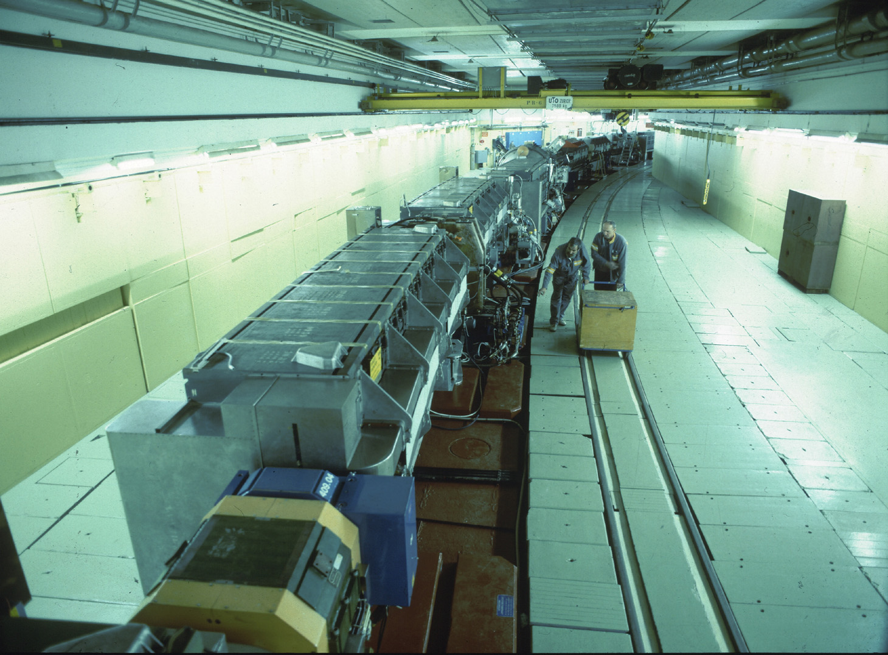
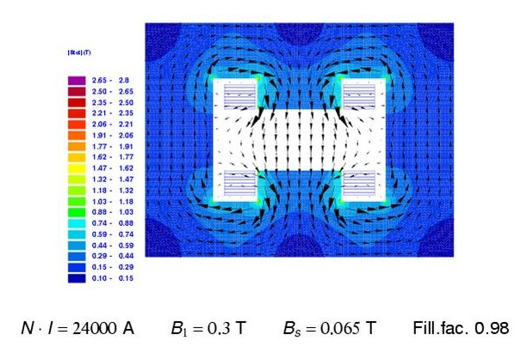
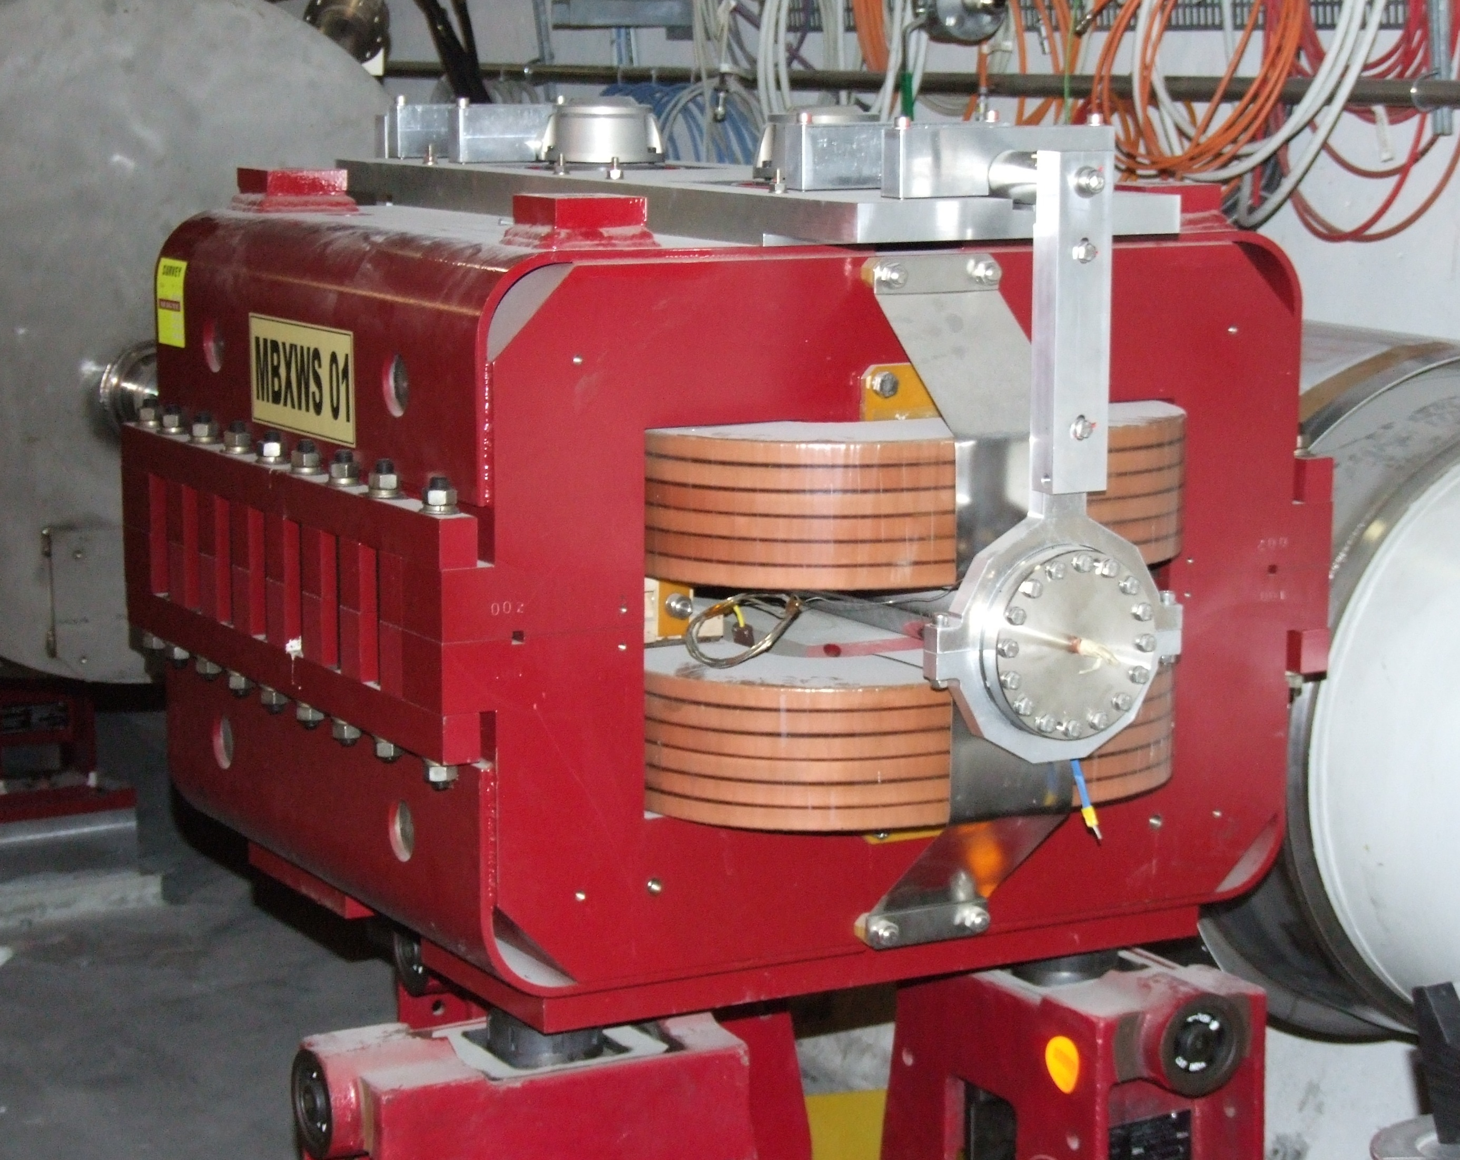
Iron Dominated Magnets

Slide 3
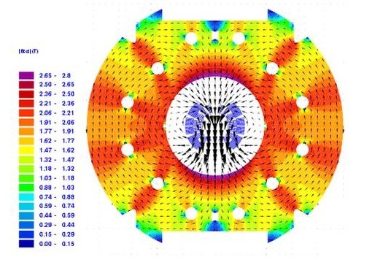
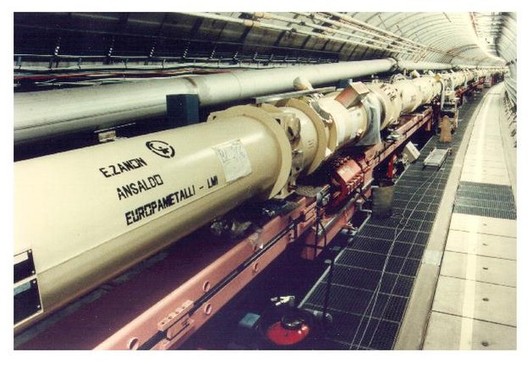
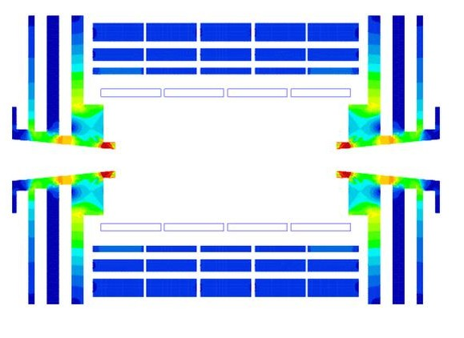
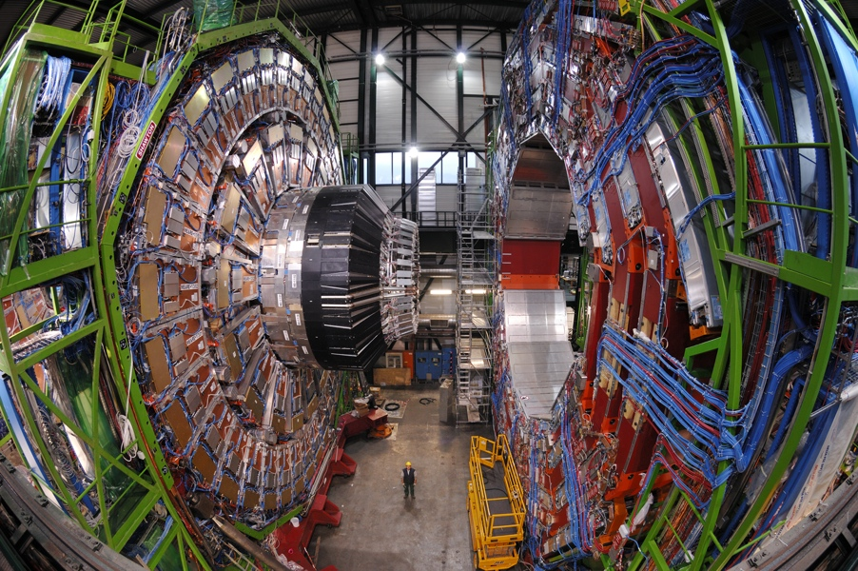
Coil Dominated Magnets
B = 8.33 T B_{s} = 7.77 T
B = 4 T B_{s} = 3.69 T

Slide 4
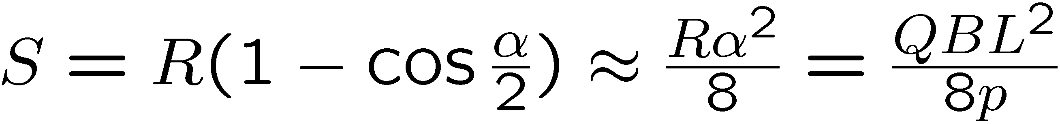
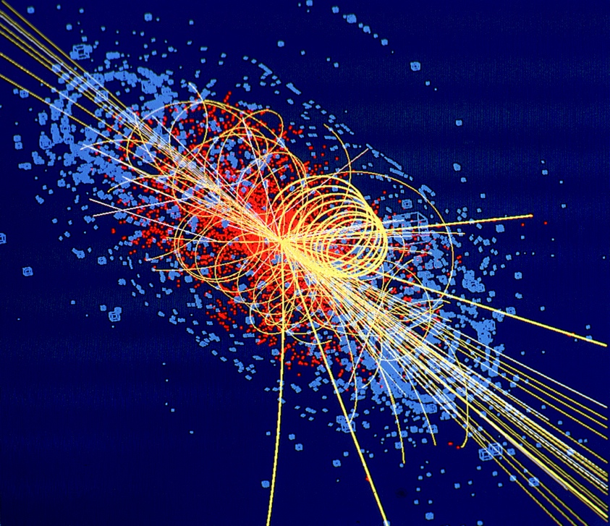
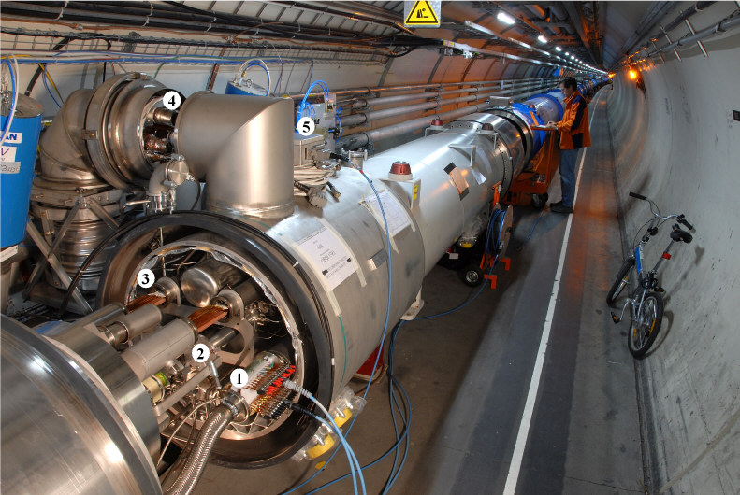
Class 1 and 2 Superconducting Magnets
Class 1
Class 2

Slide 5
Accelerator Magnets: A Multiphysics Problem
Material science: Superconducting cable, steel, insulation
Mechanics and large-scale mechanical engineering
Vacuum technology
Cryogenics (superfluid helium)
Metrology and alignment
Electrical engineering (power supplies, leads, quench detection and magnet protection
Magnetic field measurements (MM)
Analytical and numerical field computation

Slide 6
MM as a Multidisciplinary Task
Beam physics (understanding the user requirements)
Mechanics (support structures, translation stages, vibration control)
Electronics for signal processing (DAQ, filtering, amplification, integration)
Architecture (laboratory space)
Electrical engineering (power converters)
Statistics (uncertainty analysis, robust design)
Potential theory (mathematical physics) for data postprocessing
Programming
Project management (procurement of specialized components, assembly, metrological characterization)
Line management (multi-cultural, multi-disciplinary, multi-level, limited duration)

Slide 7
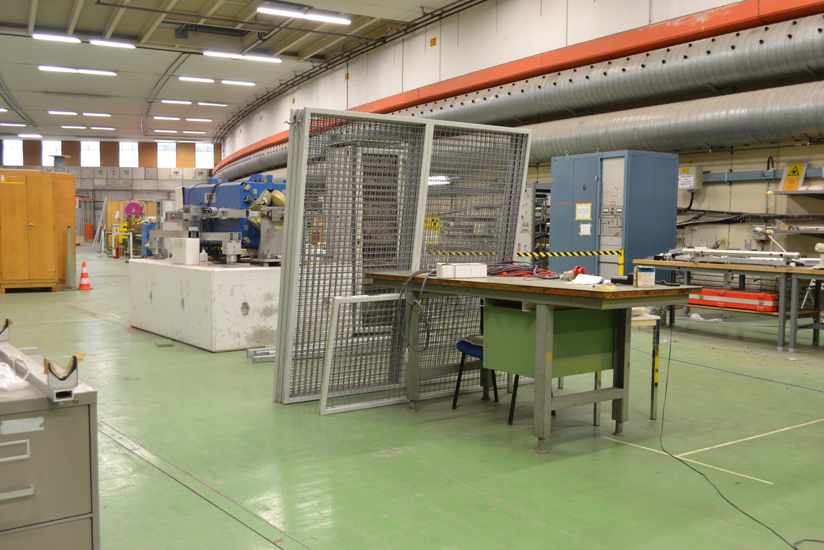
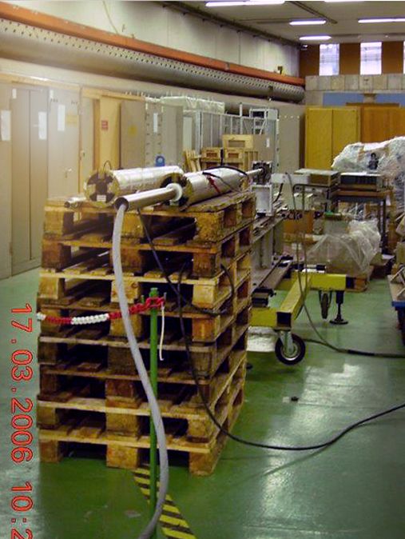
Environment: We Have Come a Long Way
ISR-Tunnel Segment: The most stable environment at CERN

Slide 8
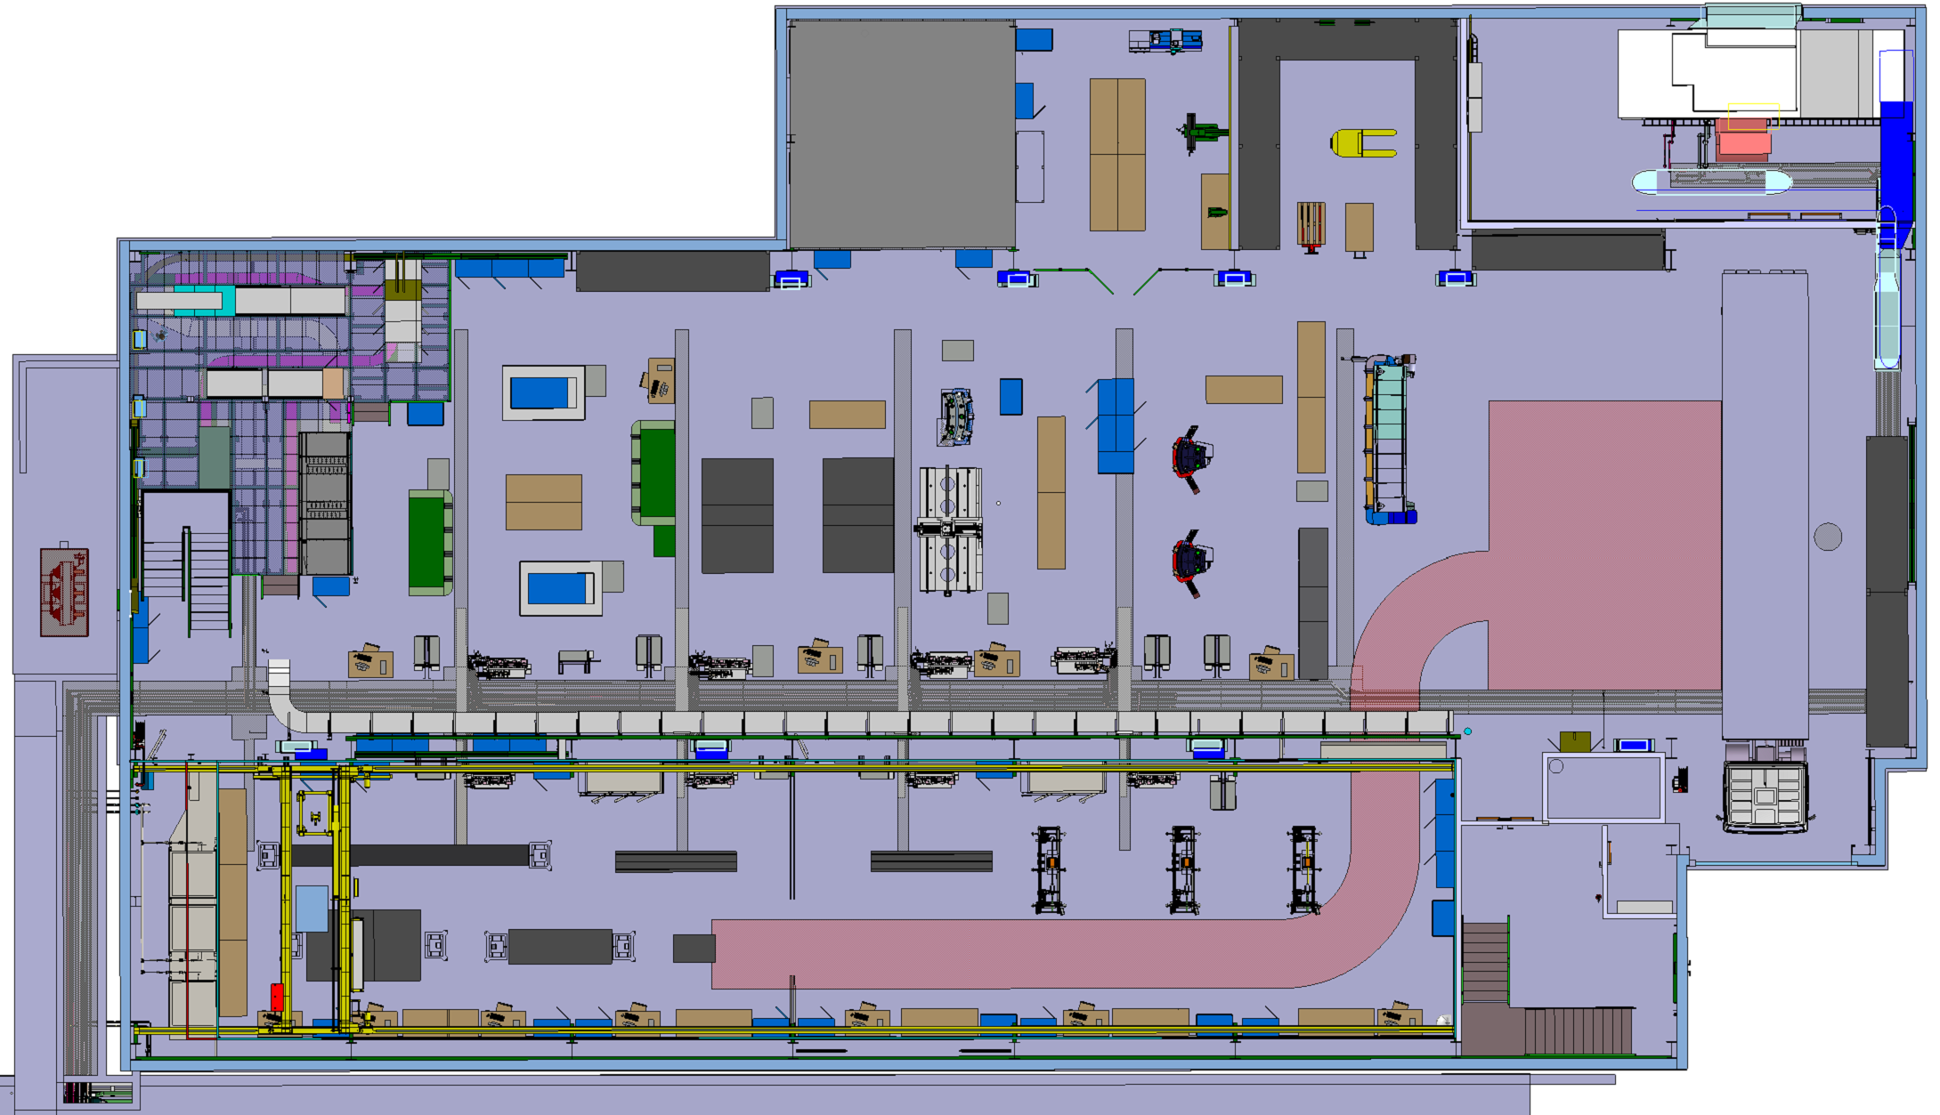
Architecture: Integration Studies

Slide 9
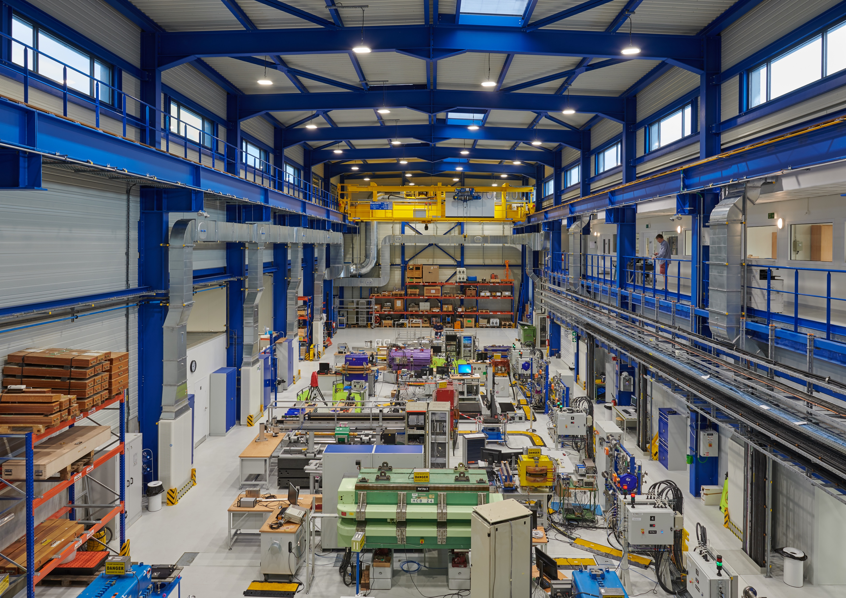
The New Measurement Laboratory 311
Lighting:
1400 Lumen
5500 K (warm daylight)
Intrinsic safety
Power converter cluster,
motorized switches,
PLC interlocked distribution
feedboxes
Air-condition system (1.4 + 0.4 MCHF)
Avoid stratification (laser applications)
Air speed < 0.4 m/sec (laminar)
+- 2 ºC in large hall, +- 0.4 ºC in “measuring room”

Slide 10
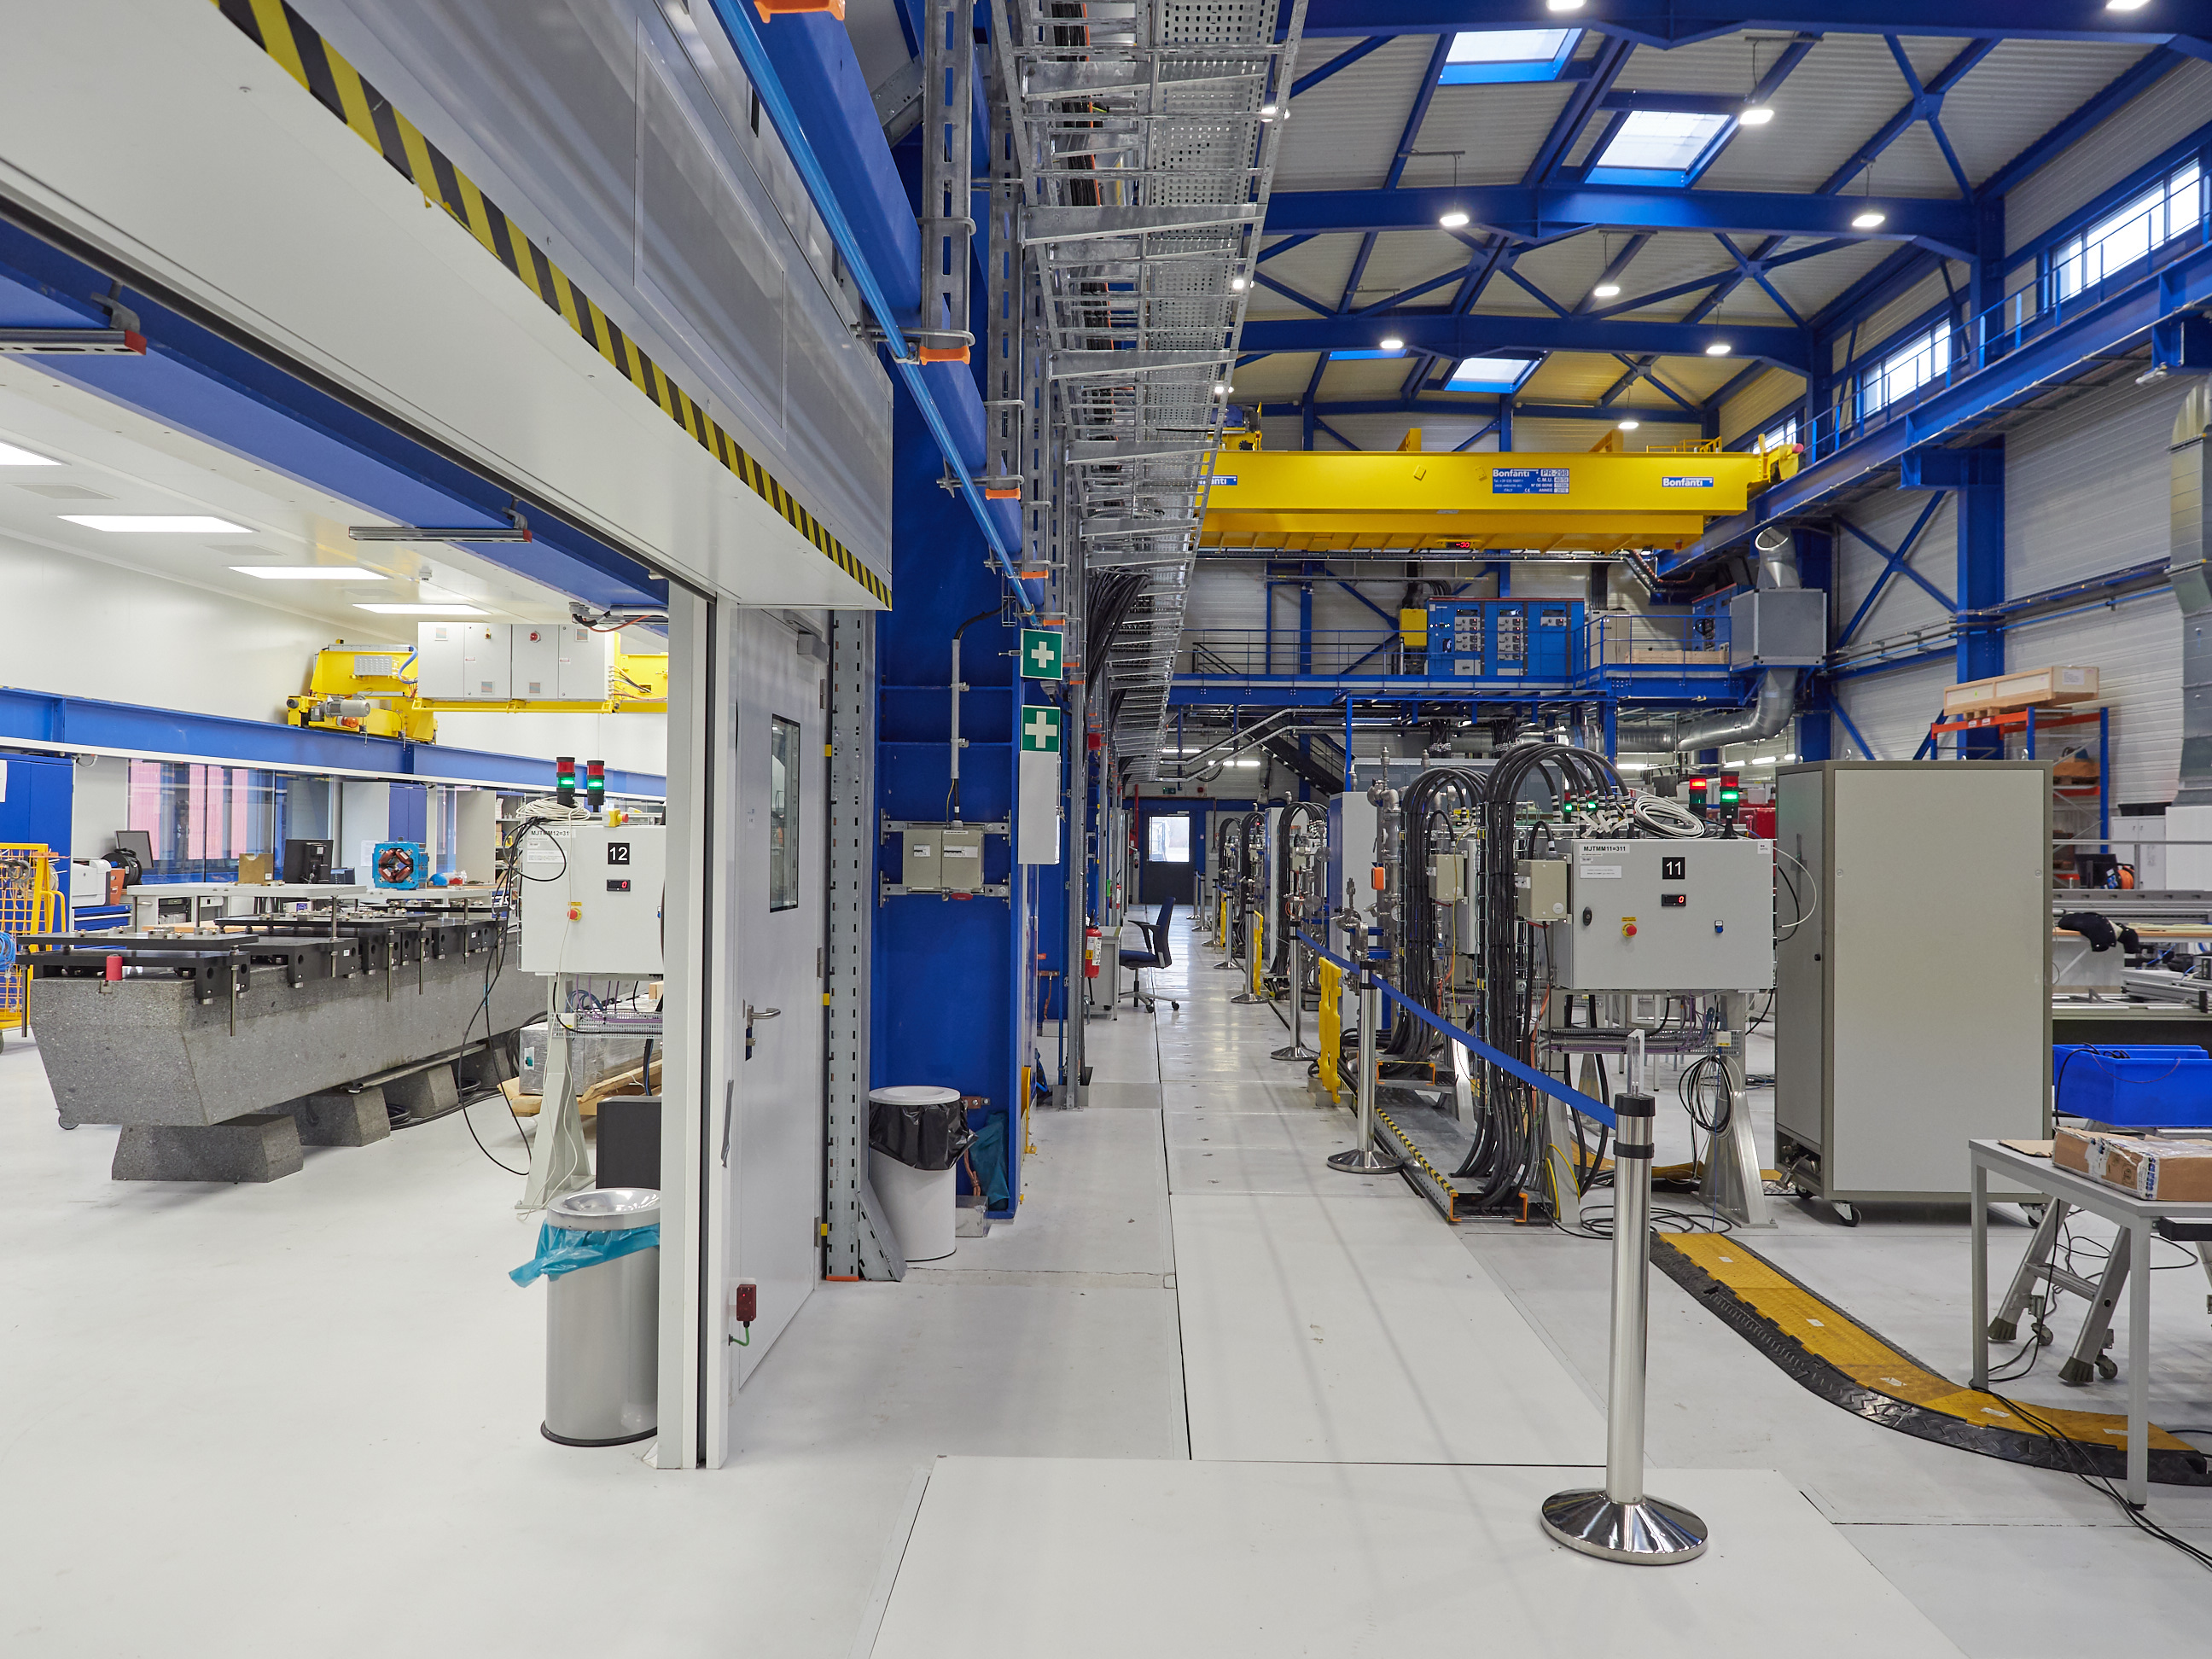
The Measuring Room: A Lesson Learnt
Vibration control:
locally
Thermal control:
globally

Slide 11
Modus Operandi of the MM Section
Hirsch-index R&D: New measurement technologies and devices (not specific to a project). Theory and proof of principle. Operational (R&D) budget. TECH/DOCT students, co-supervision with universities.
Project-driven R&D: New bench to be developed for specific measurement tasks. Project budget (CERN accelerators and approved physics experiments).
Project-driven development: Preparation of new components (shafts, coils, FFMM class). Project budget.
Win-win collaborations (partner institutes, industry): Development of special purpose equipment. External funding sources (material and personnel).
Industrial-type services: Standard measurements with existing equipment. Operational, project budgets or external funding. Technology transfer (licencing) to partner institutes or industry.

Slide 12
The Measurement Paradigm
Measurements for design
  Material properties and design choices
  Software and model validation
  Dynamic effects
Measurements for magnet production
  Prototype qualification
  Quality assurance (error tracking); acceptance testing
  Magnet to magnet reproducibility (check tolerances)
  Shimming
  Requalification after repair
Measurements for accelerator operation
  Field description (feed forward compensation)
  Field quality (resonances)
  Online monitoring (pre-cycling)

Slide 13
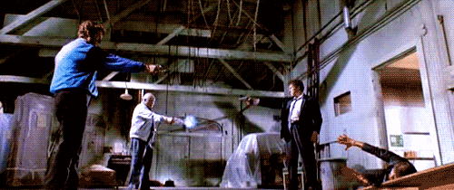
Beam Physicists, Magnet Designers, and Measurement Engineers
Everybody believes in measurements, but the measurement engineer himself.
Nobody believes in field simulations, but the field computation expert himself.

Slide 14
C³ Coherence
Magnet
requirements
Magnet spec.
Measurement needs
Machine
operation
Beam
optics
Magnet
design
Magnet
manufacture
Magnetic
measurements
Alignment tolerances
Measurement artifacts,
Unexpected physical phenomena,
Modeling and manufacturing errors
Empirical Magnet
Model
Dynamic effects
Online monitoring for machine control

Slide 15

A Few Years Later

Slide 16
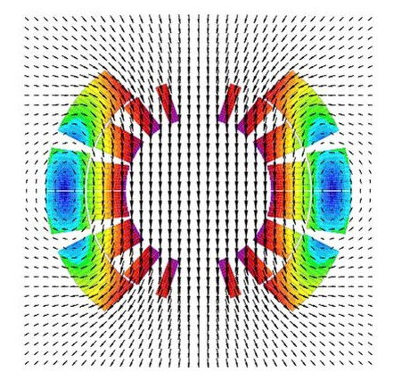
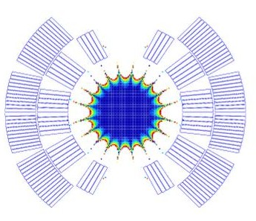
Avatars and Twins
Generalized field description from measurements (and simulations) with post-processing steps based on Kirchhoff’s theorem
2D Field map Good field region
3D Field map

Slide 17
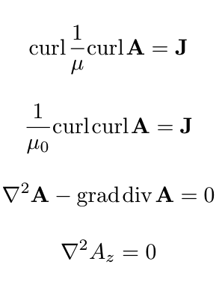
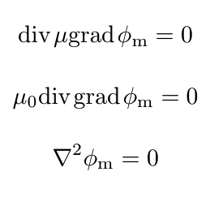
Maxwell’s House

Slide 18
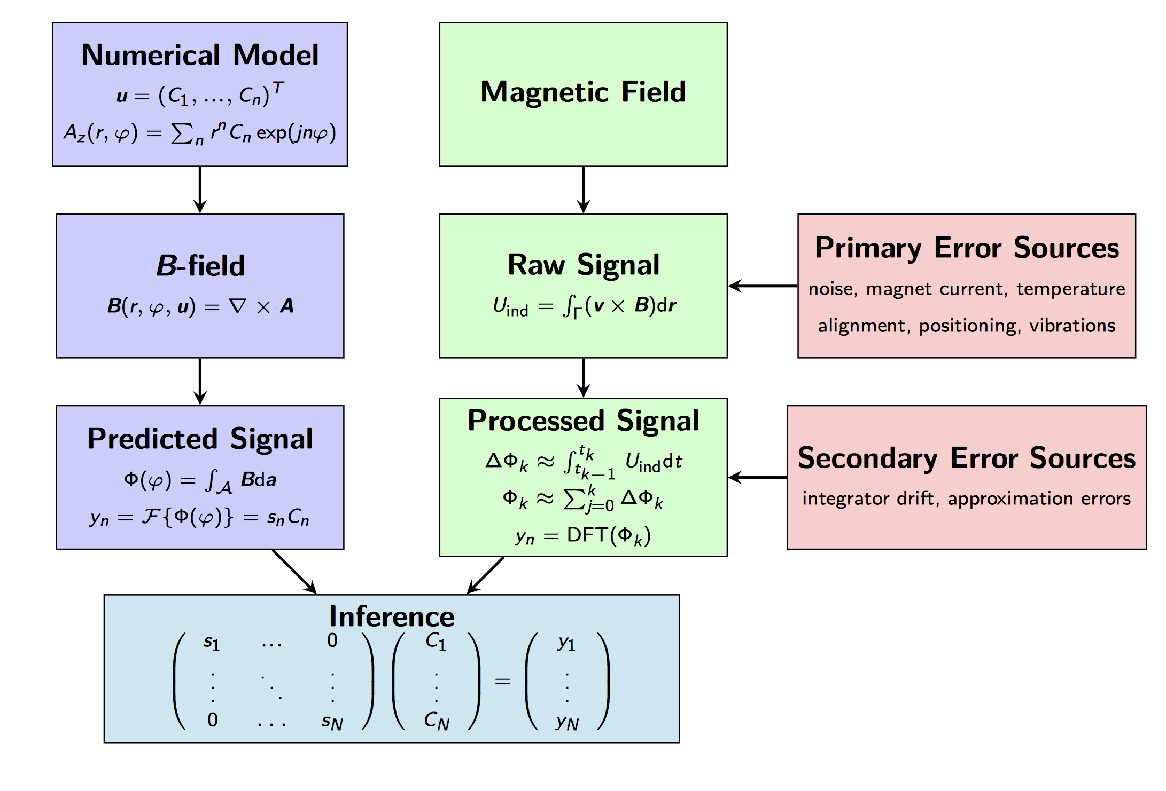
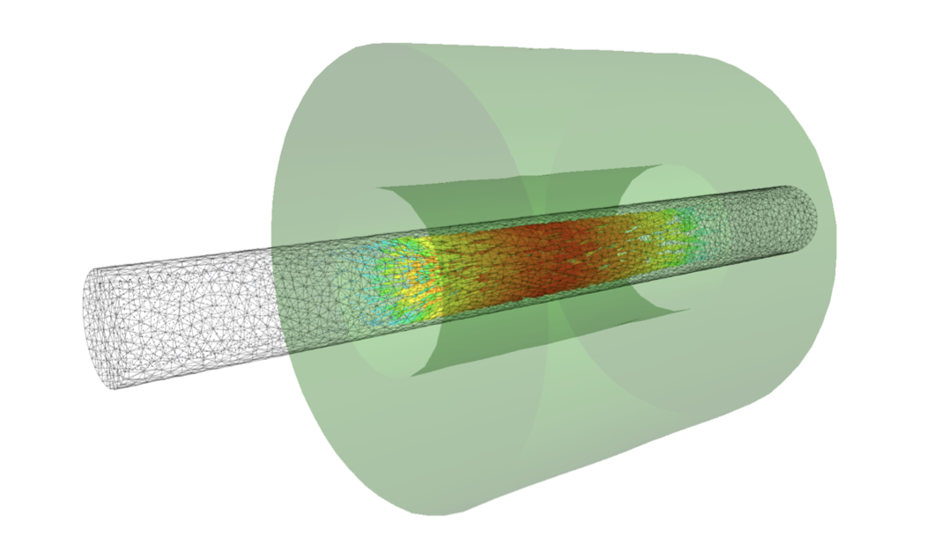
The Avatar
Numerical model (FEM/BEM
Eigenfunctions)
Magnetic
Measurement
Magnetic flux
density in Ω
Raw signal
(integrated
voltages)
Predicted signal
(Voltages, flux increments)
Processed
signal (harmonics,
flux density)
Collocation, Least-squares, Bayesian inversion (prior)

Slide 19
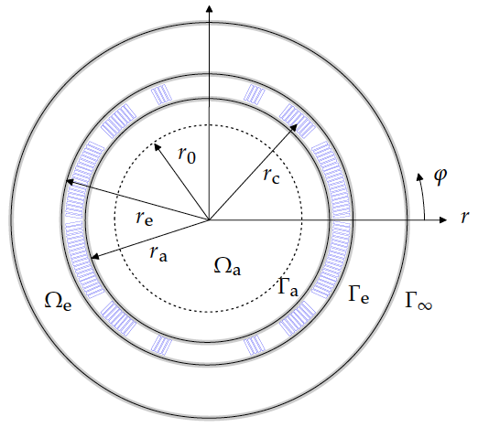

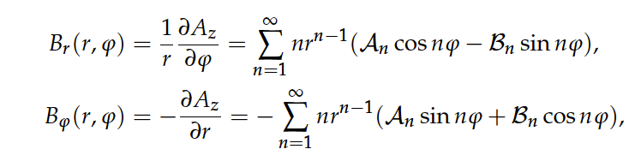
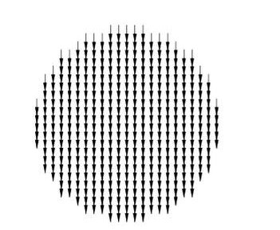
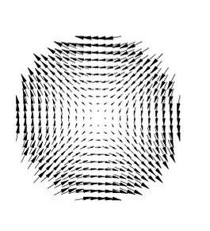
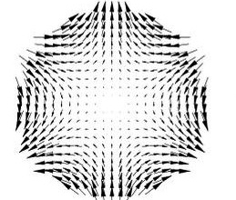
Special Case: Multipoles (Solving of Boundary Value Problems)
Eigensolutions of the Laplace equation
(coefficients are not known)
2. Calculate the field components

Slide 20


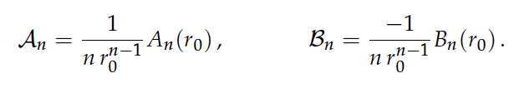
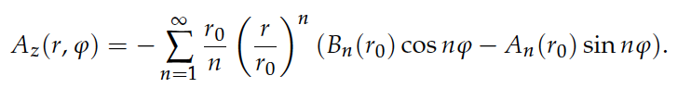
Solving of Boundary Value Problems
3. Measure the field on the domain boundary and perform Fourier
analysis (develop into the eigenfunctions). Coefficients known here.
4. Compare the known and unknown coefficients
5. Put this into the original solution for the entire air domain

Slide 21
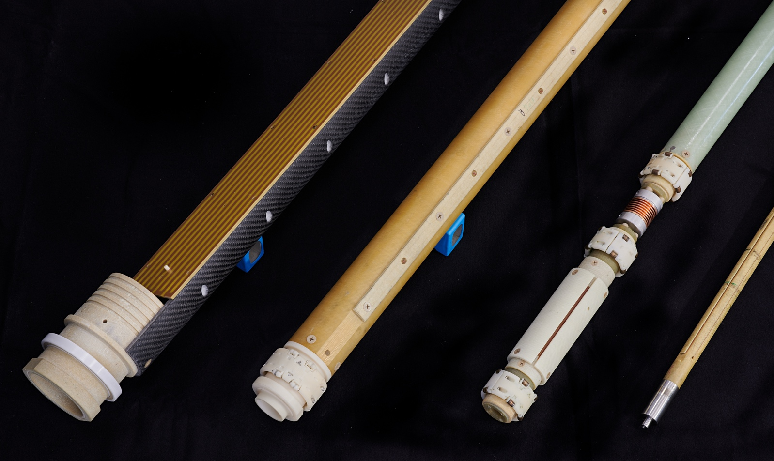
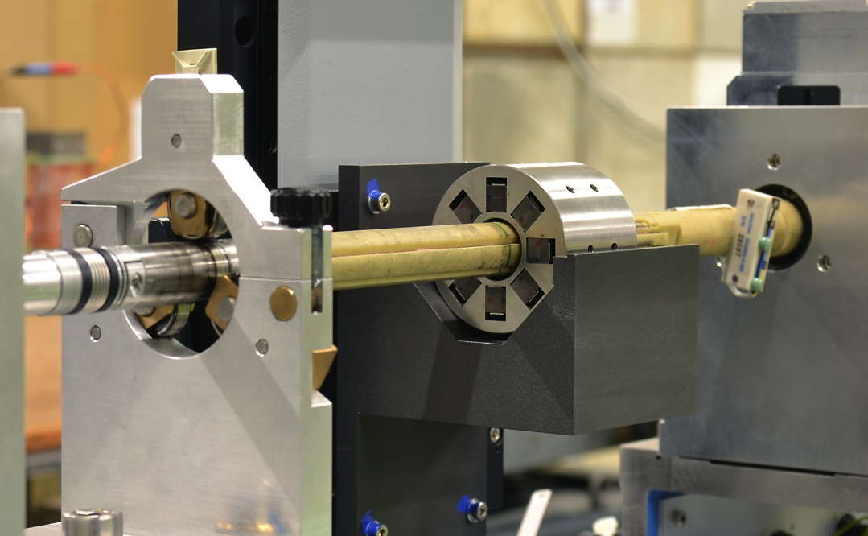
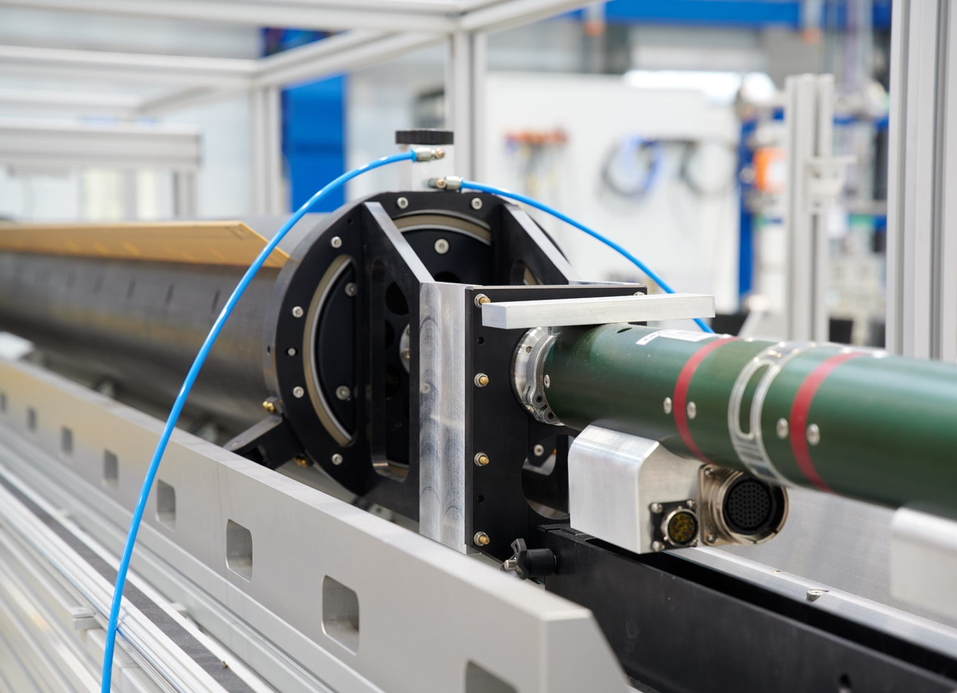
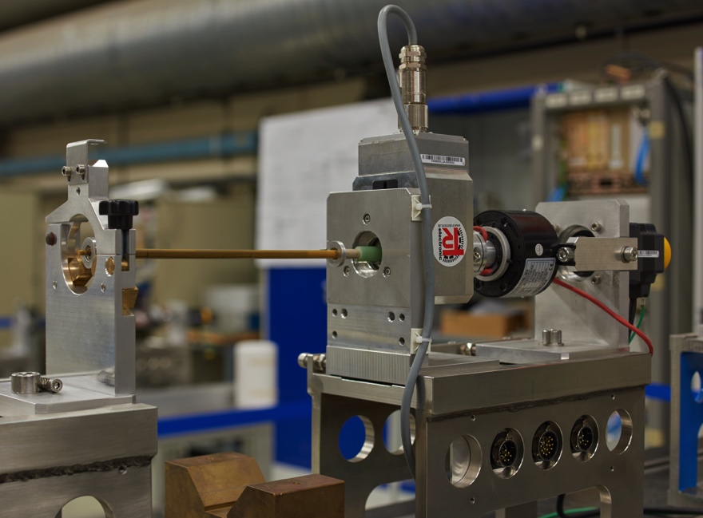
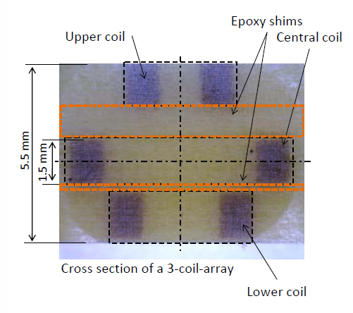
Rotating Coil Systems

Slide 22
Magnetic Measurement Techniques
Fixed coils
Rotating
coils
Transversal sensor size (mm)
FMR
NMR
Hall
sensor
Stretched wires
NMR
FMR
Longitudinal sensor size (mm)
Stretched wires
Fixed/rotating coils
relative uncertainty [-]
Hall sensor
Sensor field range [T]

Slide 23
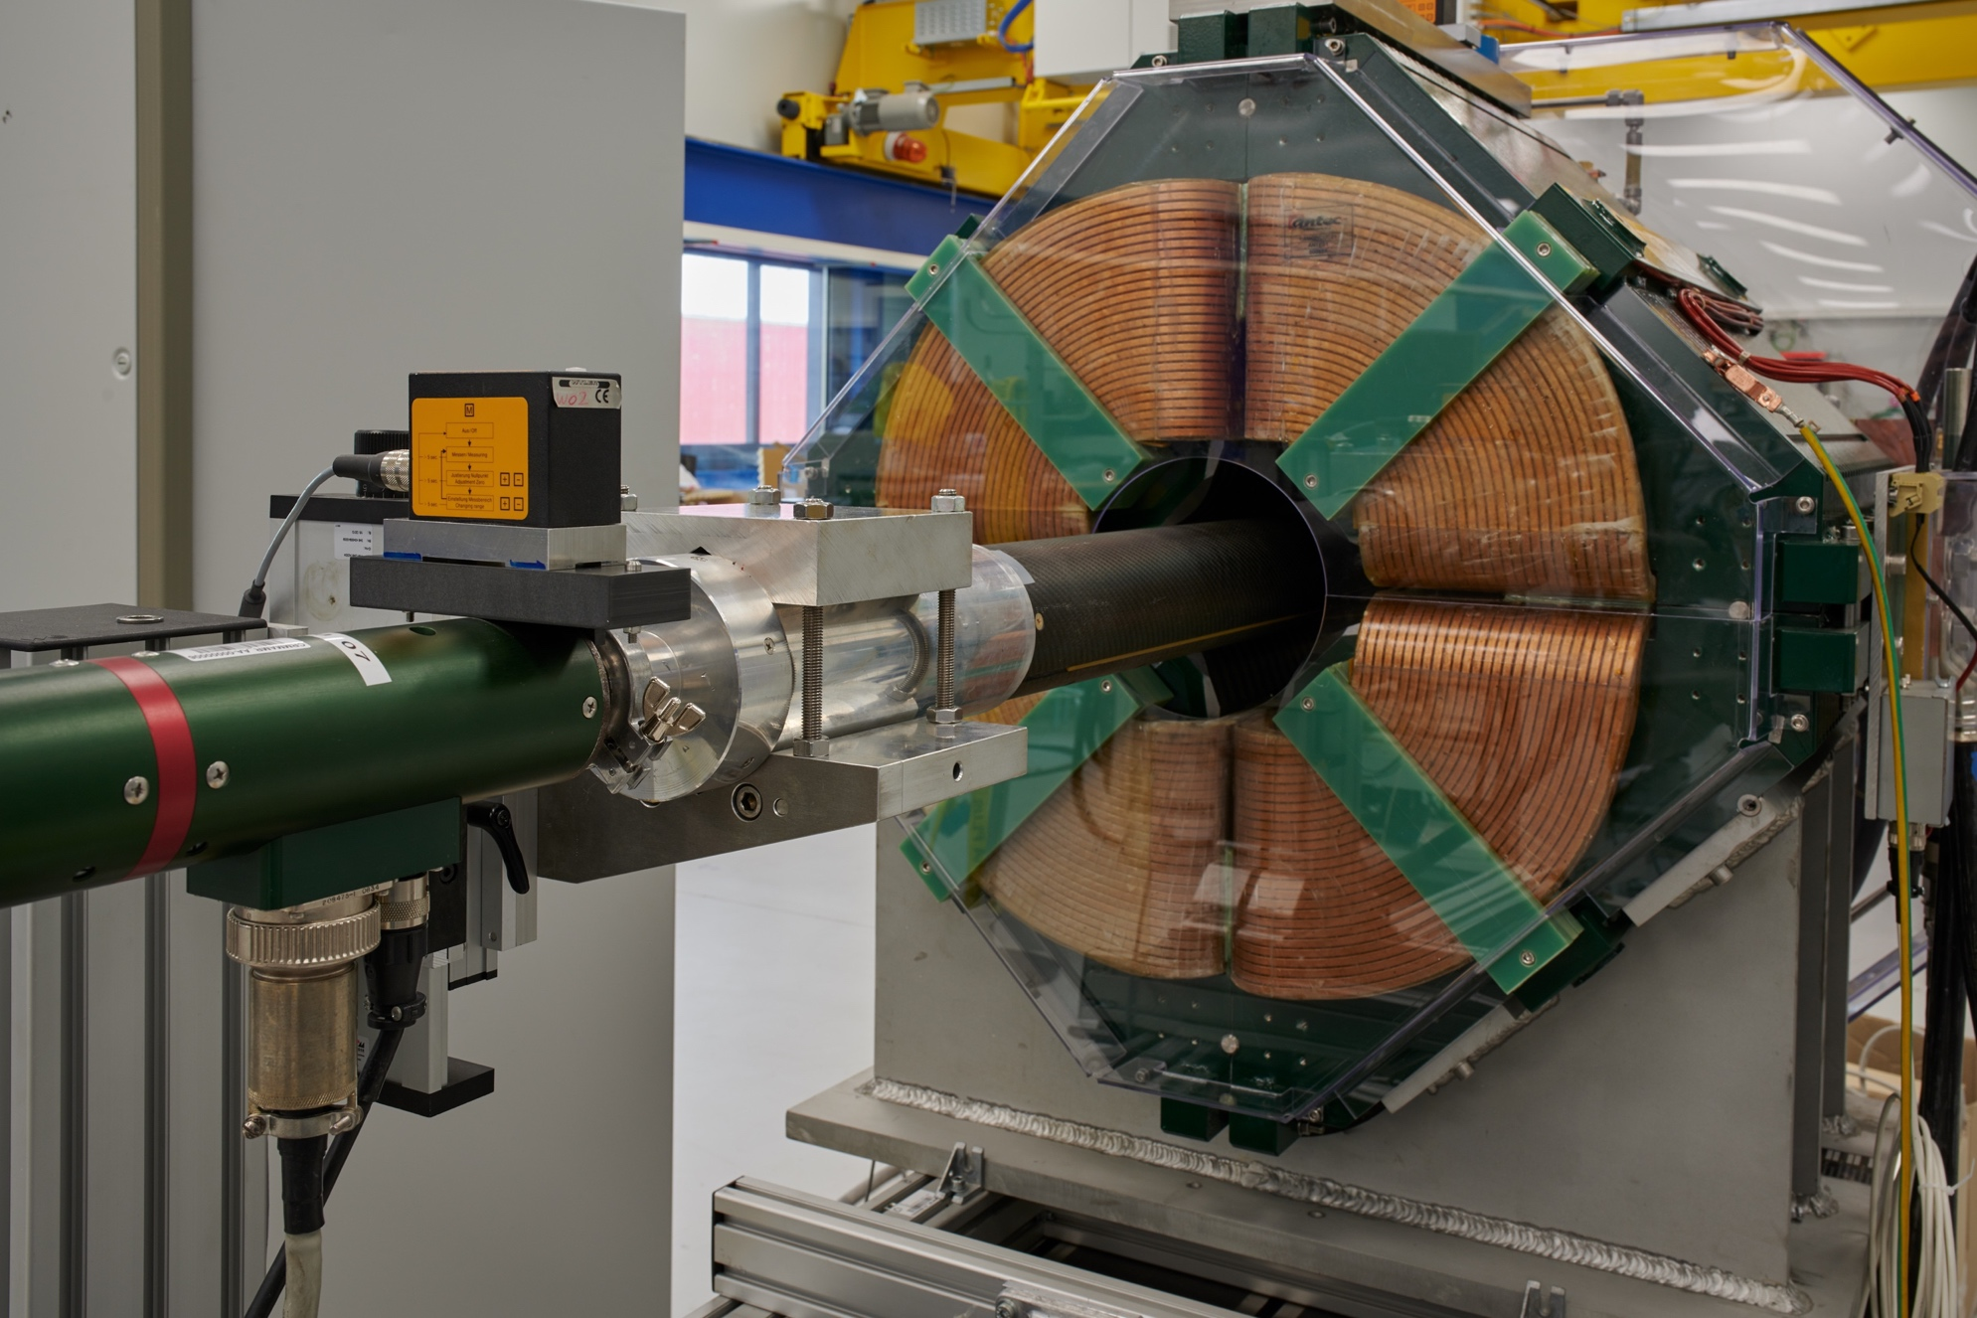
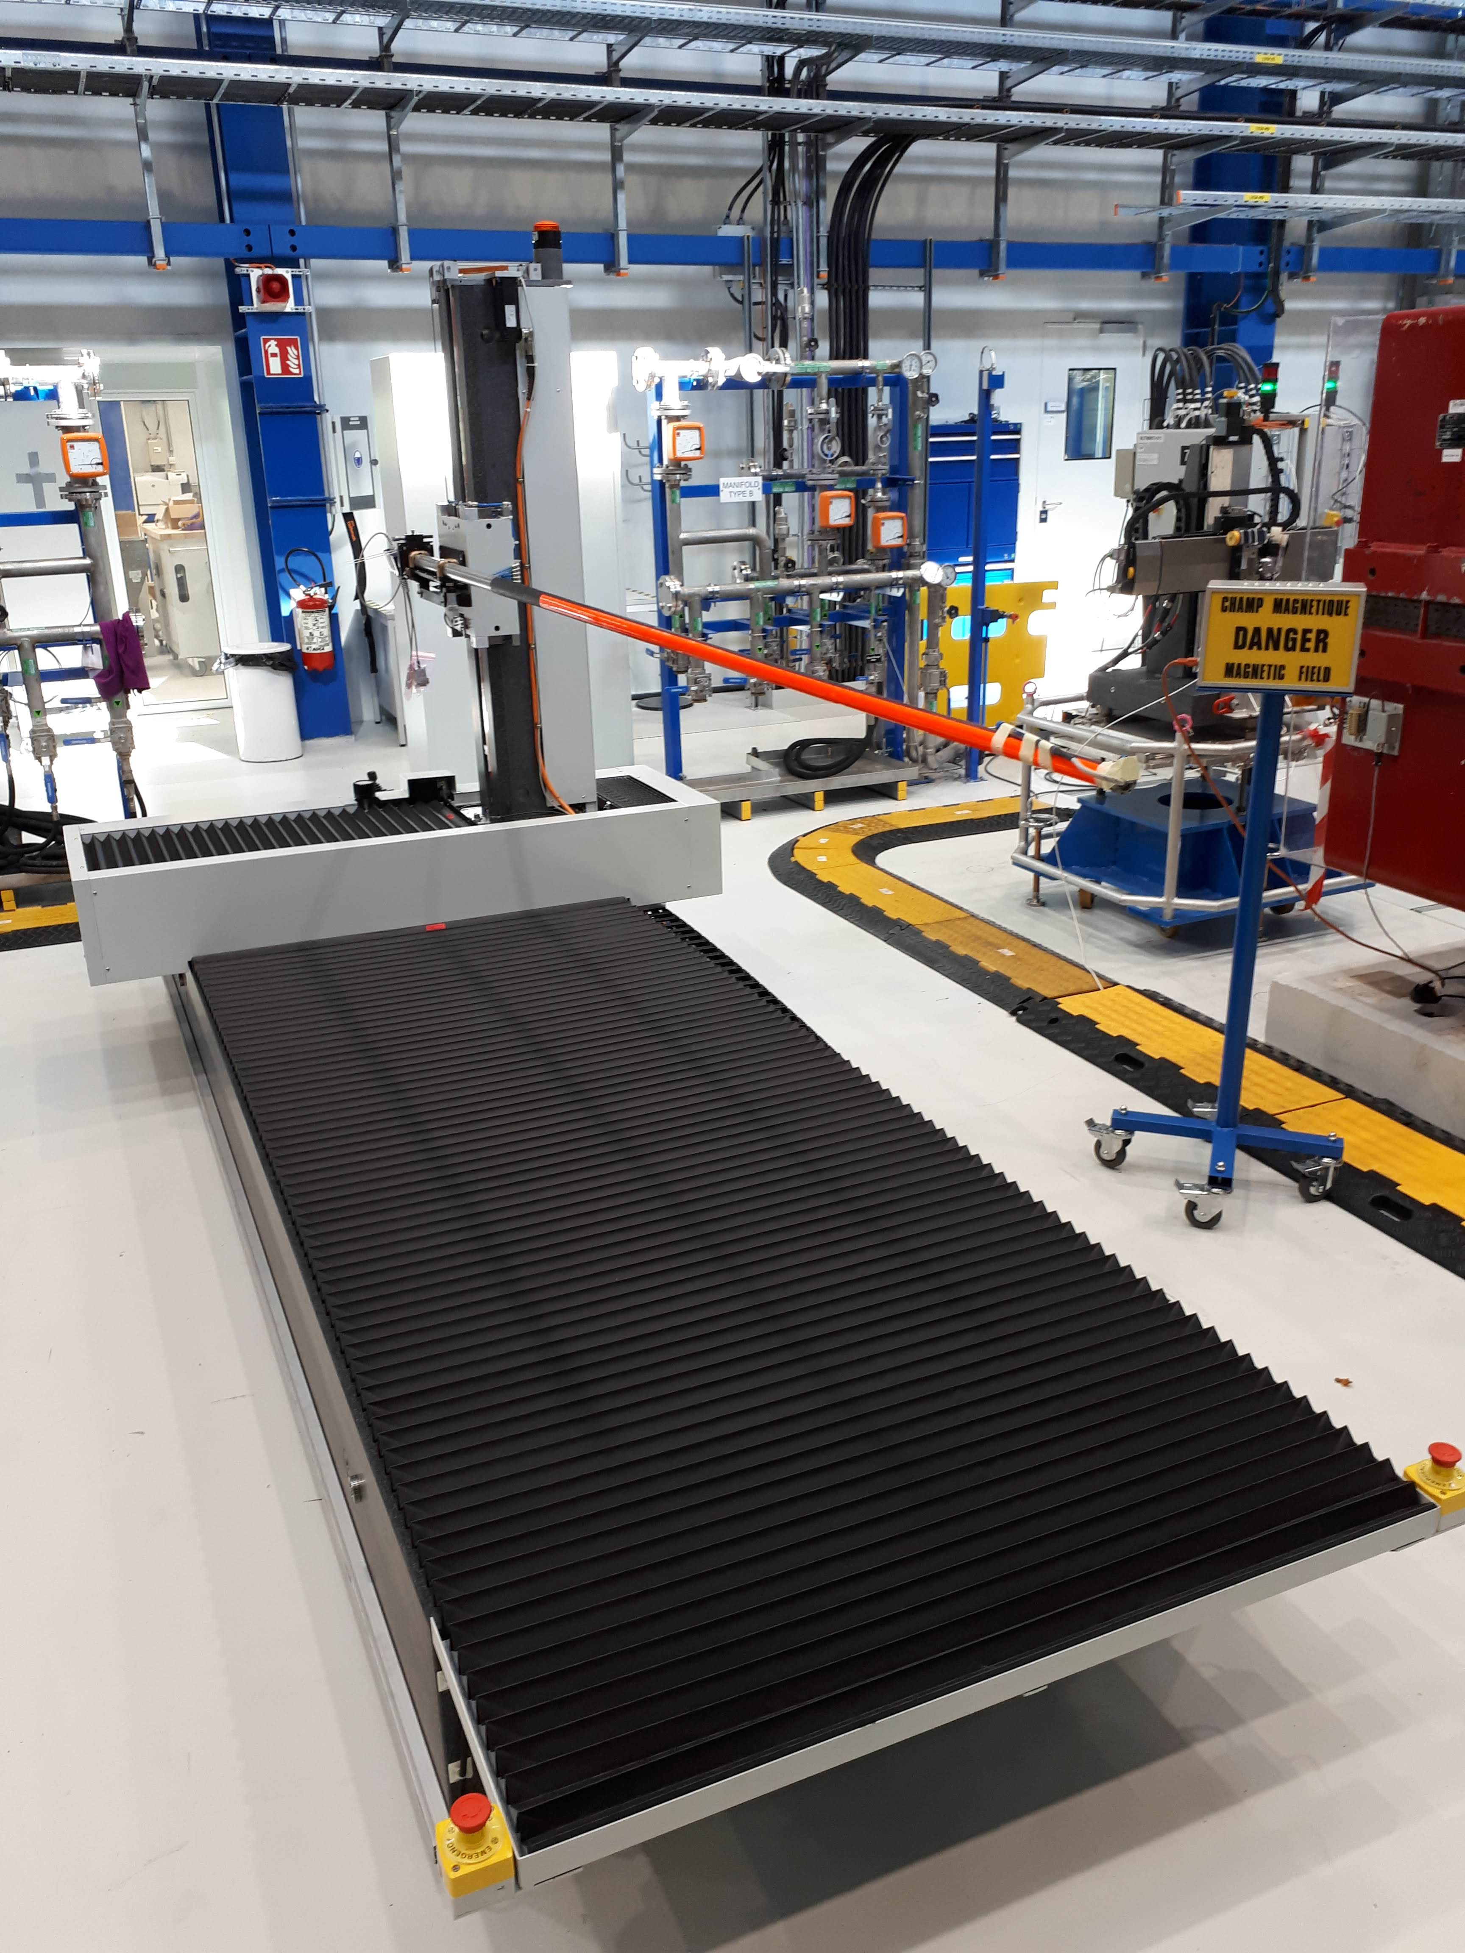
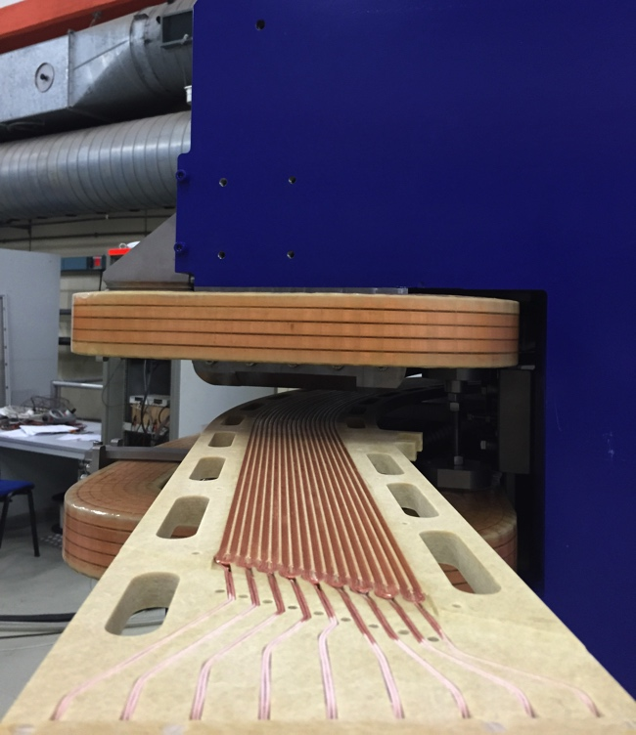
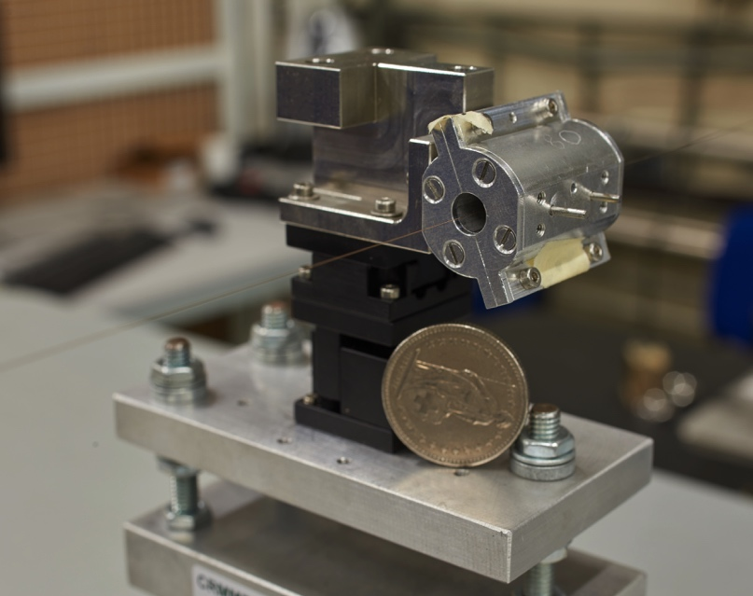
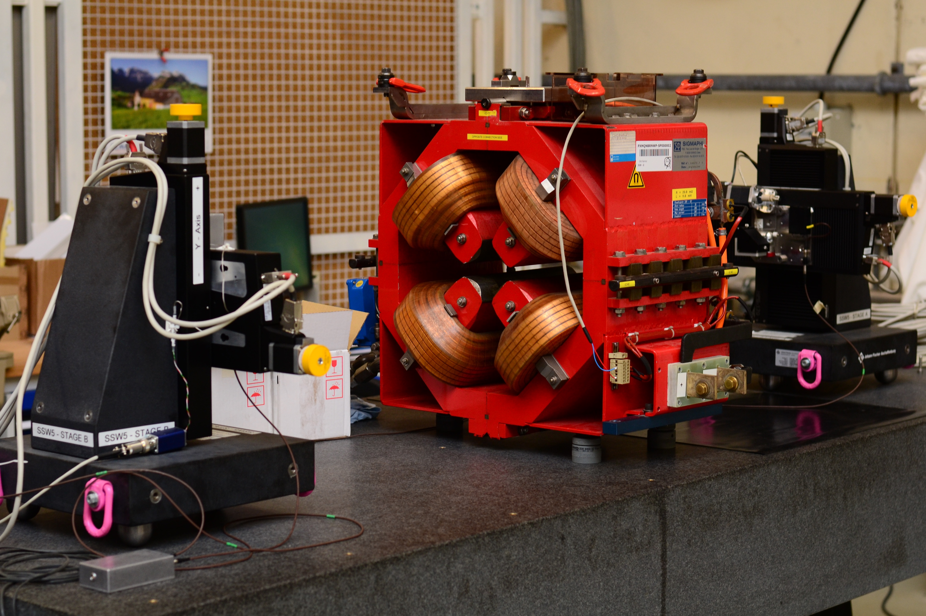
Magnetic Measurement Techniques
Rotating coil systems
Slow, least accurate
Expensive
Integrated fields only
Fast-ramped magnets only
Definition of the space-curve
Good for magnet-to-magnet reproducibility
Stretched-wire
3D Hall mapper
Stationary induction-coil
magnetometers

Slide 24
Management Tasks
Asset management
  Inventory
  Calibration data and history
  Preventive maintenance
Operations management
  Magnetic measurement requests
  Schedule and equipment allocation
  Preparation of measurement bench and MM execution
Project management
  Design (reviews) and procurement (tendering, production follow up)
Business intelligence
  Reporting
  Traceability
Resource planning
  Material budget and resources (personnel)

Slide 25
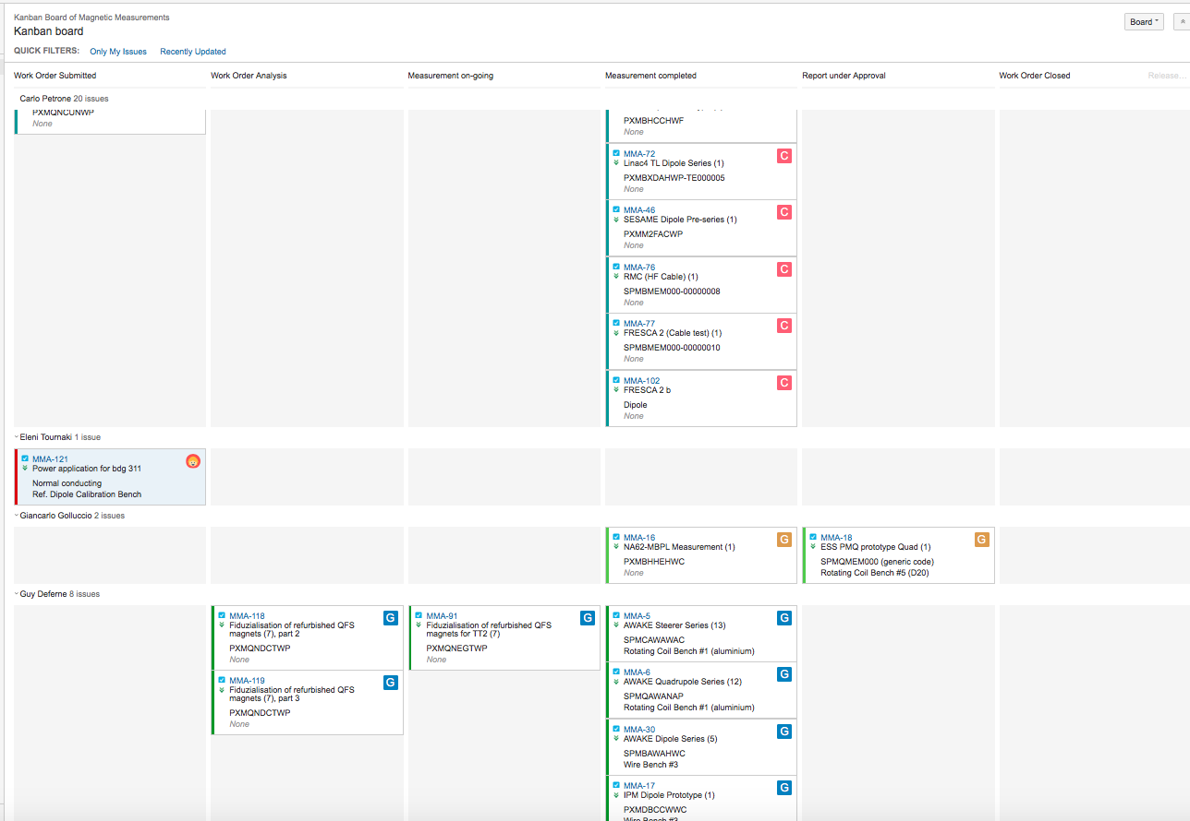
Scheduling (Kanban Board)
ATLASSIAN Jira

Slide 26
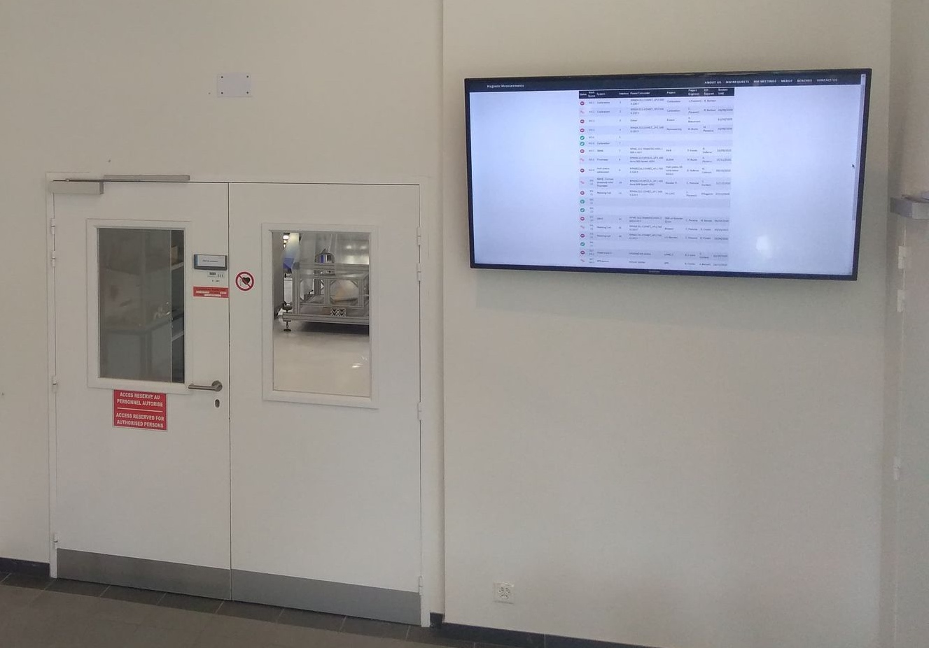
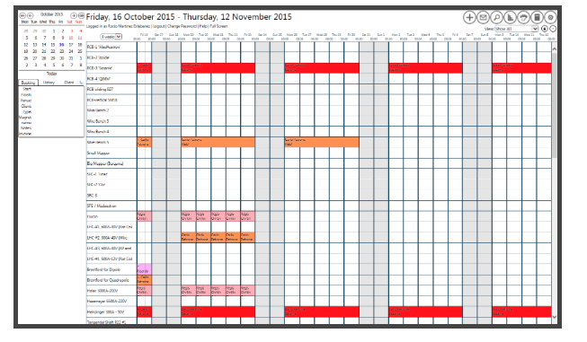
Space Management
Booking tool (Midas)
Bench status display
(Drupal 8 Website)

Slide 27


The Problem Setting
Operations management
Project management and
Business intelligence
Client
NC magnet
MM requests
SC magnet
Processed data
Released data
Material
Raw data
FSU job request
FFMM config.
MM report
Bench preparation
Client
Kanban Board
Kn
Calibration data
Traveller
NORMA
EDMS
MTF
MM Equipment
Asset management
Database “management”

Slide 28
Certification Requirements (ISO/IEC 17025)
General
Accountability, impartiality, confidentiality
Resources
Staffing, training
Environment, equipment, traceability
Processes
Customer relation
Proper naming convention
Electronic logbooks
Propagation of uncertainty (GUM)
Record equipment meta data
Restrict access to calibration equipment
Automatic generation of protocols
Centralized data storage
Management systems
Quality assurance and audits
Production readiness
Documentation

Slide 29
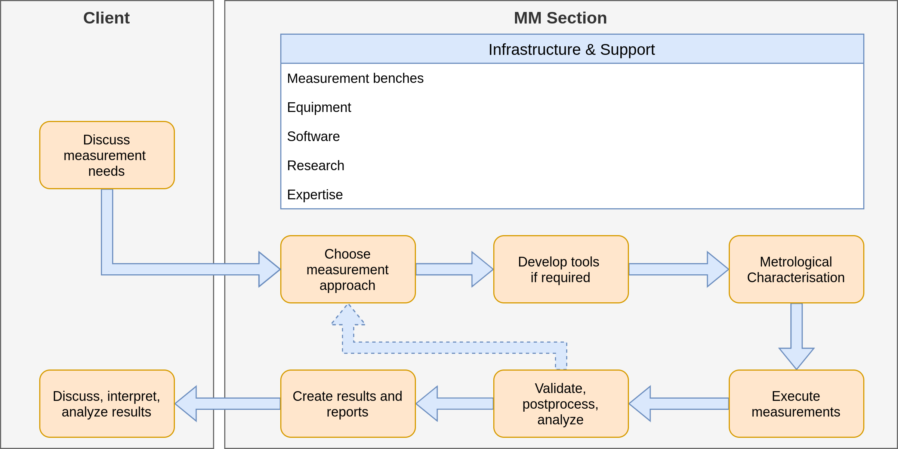
The MM Value-Shop Model

Slide 30
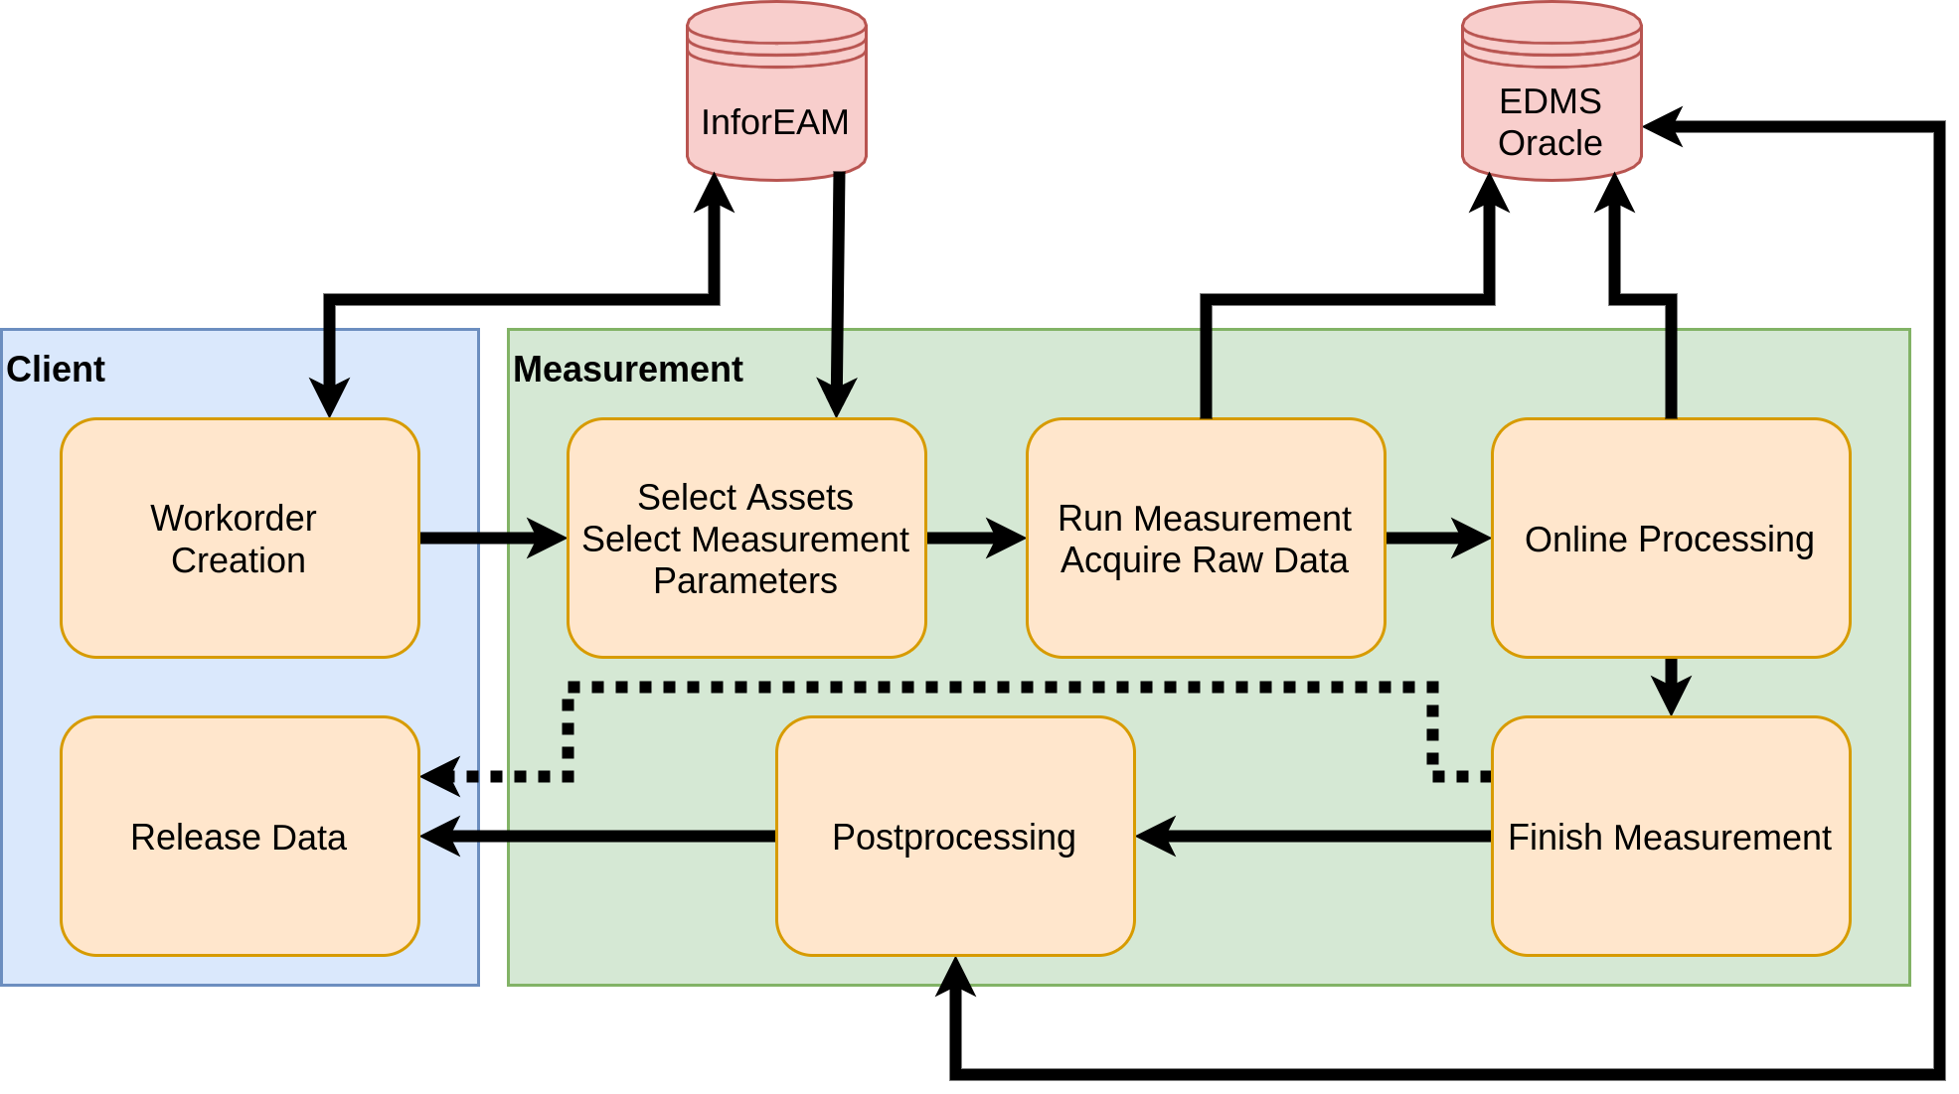
Measurement Dataflow

Slide 31
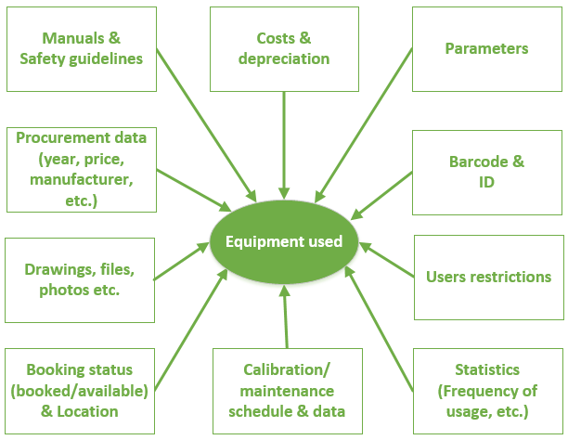
EAM (Enterprise Asset Management)
Why InforEAM
Used throughout CERN
service, maintenance and support provided by a dedicated Section at CERN
Integration with other CERN systems (EDMS, MTF, TREC, etc.)
Can be integrated with other web-services
Customisable with some restrictions

Slide 32
Magnetic Measurement Requests and Workorders
Equipment code
Post-processing
Phase
Request
Phase
Synopsis
(MM Report)
Requestor’s timeline
Released
(MM Protocol)
Other information from requestor
Raw and processed data
Work-order
Information from NORMA / MTF
MM procedures and parameters
Assignment of resources
Definition of MM procedure
Equipment used
Preparation
Phase
Scheduling
Execution
Phase
Development and procurement

Slide 33
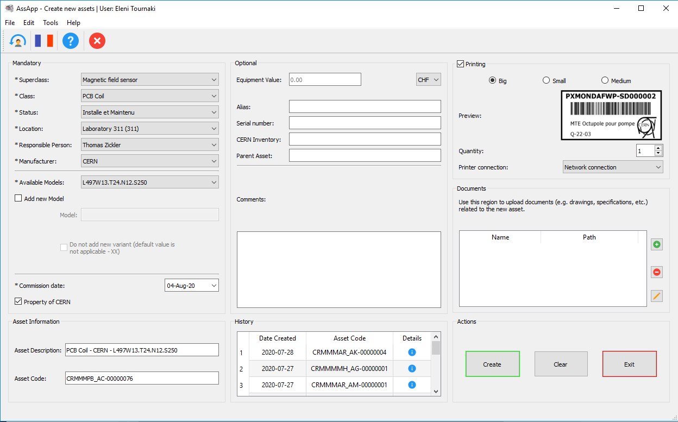
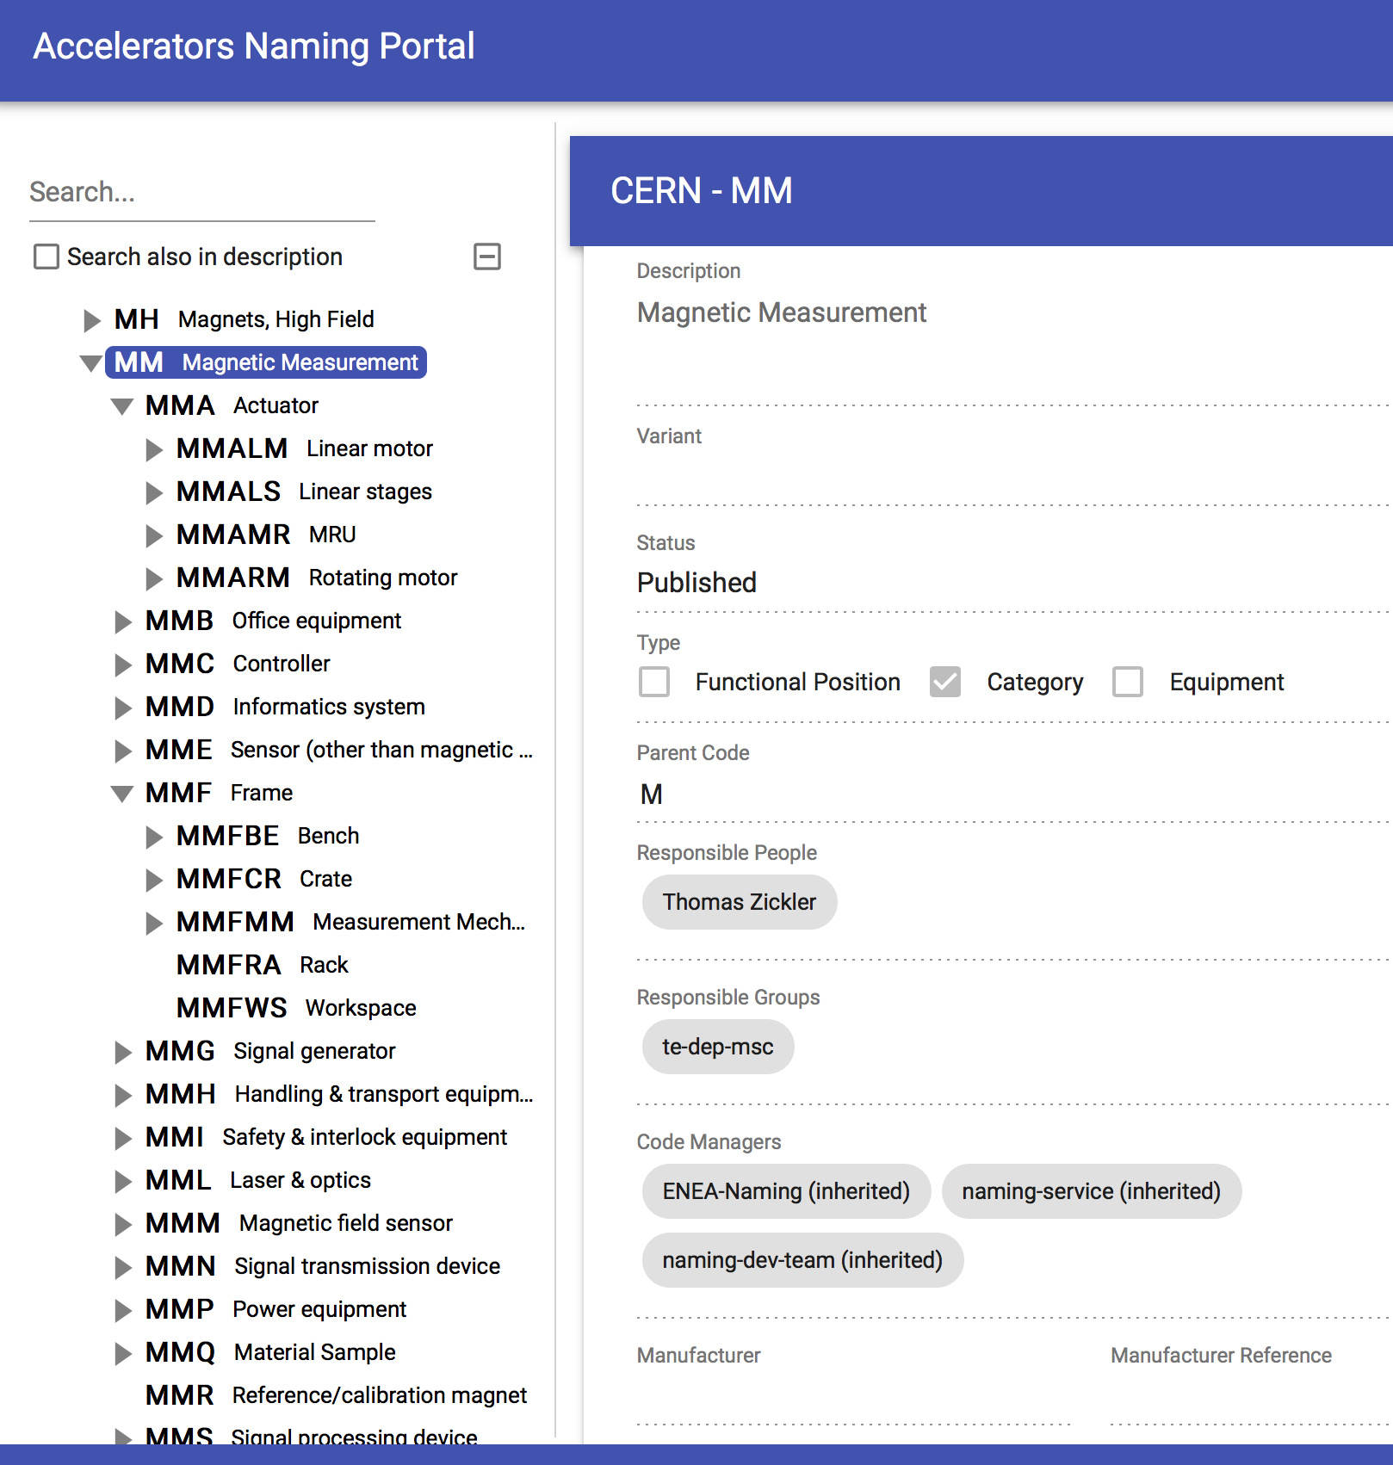
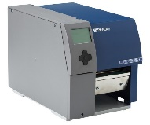
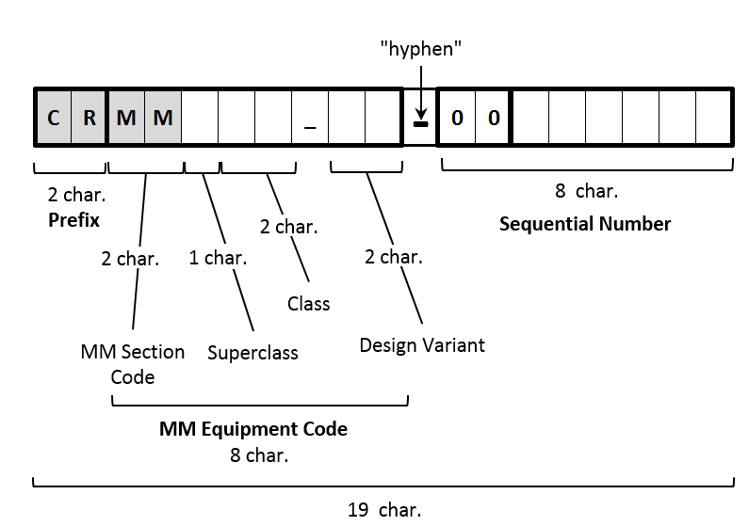
Device Registration and Asset Codes
  Crucial for magnetic measurement
  Holds/pushes data required in FFMM
  Requires regular maintenance and calibration
  Exceeds a defined financial value
  Unique and frequently used

Slide 34
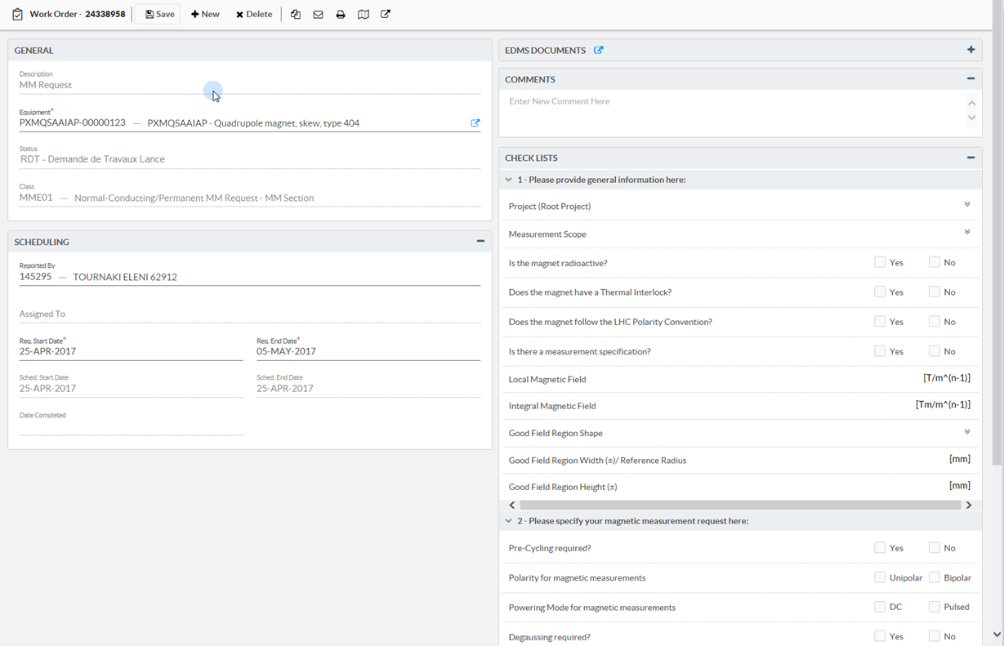



The Interfaces
MM Request
(Client)
Workorders (Events in EAM)

Slide 35
Naming Conventions
Magnetic field-sensing devices
  Scalar fields: Nuclear magnetic resonance (NMR), electron spin resonance (ESR), superconducting quantum interference devices (SQUID
  Vector fields: micro-electromechanical, magnetoresistance, Hall effect, fluxgate.
  Integral (vector)-field quantities: Vibrating sample, fibre-optical (Faraday effect), torque (cantilever), induction coil, and single-stretched wire.
Transducer
  Comprises the sensor and any axillary electronics needed to convert the magnetic flux (density) into an electric voltage at its connection terminals.
Induction-coil devices
  Rotating-coil magnetometers, translating-coil magnetometers, stationary induction-coil magnetometers (fluxmeters)

Slide 36
Naming Convention
A single coil of the magnetometers is called an induction coil.
  An ordered set of induction coils is called an array. A cylindrical induction-coil array is called a segment.
    A shaft is made from one or more segments.
      A chain is a series of connected shafts.
A rotating-coil scanner, and a translating-coil scanner are devices consisting of a shaft or induction coil-array mounted on a one-dimensional displacement stage.
A displacement stage for at least two dimensions is called a mapper.
The measurement system comprises the bench, the actuators, motor drives, the transducers, the data acquisition system, the digital integrator, and the software framework (FFMM).
  A bench is the mechanical support structure for the magnet and the measurement system.
    A workspace comprises the measurement system, the magnet, and the allocated floor space in the measurement lab.

Slide 37

Polarity Convention, Positioning, and Alignment
Consistently
oriented
Non-consistent inner and outer
orientation: to be avoided
Definition of d and q axes
and the (mis)-alignment angles

Slide 38
Asset Codes (Coil Magnetometers)
Segment asset code
CRMMMCO_AA-00004550
CRMMMCO_AA-00004450
CRMMMSE_AA-00000268
CRMMMCO_AA-00001949
Shaft asset code
CRMMMCO_AA-00002229
CRMMMCO_AA-00000583
CRMMMSH_AA-000000657
CRMMMSE_AA-00000245
CRMMMCO_AA-00089001
CRMMMCO_AA-00000230
CRMMMSE_AA-00000233
CRMMMCO_AA-00005768
CRMMMCO_AA-00006778
Coil
Track dimensions
Contraction factor
Material type (support)
Material type (wire)
Number of turns
Consistent orientation (y/n)
Coil inner length
Coil inner width
Winding width (trans)
Winding width (longitudinal)
Coil height
Number of layers
Coil surface (theoretical)
Coil surface (calibrated)
Resistance
Temperature
Calibration date
Material orders
Calibration raw data
Drawings
Design files
Shaft
Total number of coils
Total geometric length
Plane position (mm)
Geometric radius
Tangential/Radial
Connector position
As link in a chain (y/n)
Calibration validity
Material orders
Drawings
Segment
Material type
Calibration date
Kn (generic)
Kn* (calibrated)
Calibration raw data {N}
Drawings
Cabling scheme
Coil in segment
Coil asset code
Coil position
Radius
Beta
Alpha
Delta alpha {N}
Delta beta {N}
Normal orientation (y/n)
Polarity (+/-)
Connector type
Pin number A term
Pin number B term
Segment in shaft
Segment position

Slide 39
MM Equipment Lifecycle Measurements
Assign
Equipment
Code
Procurement
Variant
N+1
Calibration
Operation
Decom-
missioning
Design
Assembly
Metrological
characterization
Preventive
maintenance
Corrective
maintenance

Slide 40
Data Flow
Meta data are equipment codes, calibration data, environmental data, logfiles
Raw (analog) signals coming from the transducers (induction coils, Hall sensors), which are the voltages over their connection terminals.
Raw (digital) data are the signals at the port of an AD converter and of a synchronized timing card which allows to establish the numerical values of U(t). The two functionalities are combined in the digital integrator card (FDI) developed at CERN, which yields the measured quantity Φ(t).
Pre-processed data are raw data after some post-processing, which include averaging, filtering, integrator-drift correction, and correction for the instruments input resistance, among others.
Output data (MM results) are pre-processed data that has undergone additional processing steps, such as digital bucking, deconvolution, and Fourier transform. The results are stored in measurement protocols that are automatically uploaded to the database by means of the software framework (FFMM) and the asset management system (Infor EAM) .
Released data are validated and analyzed data that are compared to the magnet specification (conform, nonconform, uniformity). Released data are presented in reports uploaded on the database via CERN's Engineering Data Management System (EDMS).

Slide 41




Data Flow
Bench
setup
Data
processing
DAQ
Analysis
Measurement script
Parameters
Raw data
Pre-processed data
Output data
Protocols
Released data
Reports

Slide 42
Uncertainty and Mitigation Measures
Application
MM-Method
Types of uncertainty
Mitigation
Long (SC) magnets
(LHC arc dipoles
and quads)
Long rotating
coil magnetometers
(integrated mulitpoles)
Approximation
(incomplete basis)
Cauchy estimate
Calibration
Systematic
Cross-calibration
Large aperture quads
(HL-LHC inner triplets,
SuperFRS multiplets)
Stretched wire
(magnetic axis)
In-situ calibration
Intrinsic
(false assumptions)
Short (isoperim.) coils
Oversampling
Integration
Bucking
Spectrometers
Moving fluxmeter
Random
Experimental magnets
Gantry
Hall mapper
(field maps for
track reconstruction)
Deconvolution
Local Maxwellification
Solenoids
(Anti-proton traps)
Bayesian inference
Solenoidal-field
transducer
Sensor fusion
Ignorance
(incomplete
physical model)
Strongly curved
magnets
Curved wire

Slide 43

Sources of Uncertainty
Random errors (capture and read-out noise). Oversampling (repeated measurement, averaging, learnt statistical analysis (type A evaluation)), signal compensation (bucking), a stable mechanical support, and vibration damping. These errors are the least concern in magnetic measurements.
Systematic errors. Calibration, ideally traceable to primary metrological standards. Tight control on the environment (laboratory conditions), polarity inversion, sensor reversal, go-and-return (compensate for integrator drift), comparison with references (type B evaluation).
Correlation (covariance), propagation of uncertainty and design of experiments: Guide to the Expression of Uncertainty in Measurement (GUM)

Slide 44
Sources of Uncertainty
Operator (gross) errors may arise from using the wrong calibration data for an instrument, or attributing the measurements to a wrong equipment code. Linking asset management with DAQ systems.
Approximation errors from the projection of the measured data onto Fourier polynomials (of order N), truncated Taylor series, wavelet expansions, or sparse finite-element meshes. Convergence studies.
Intrinsic errors from a (false) assumption of linearity of the sensor response or by non-orthogonal sensors. “Maxwellification” in a post-processing step (avatars).
Ignorance from model reduction. Limitation of the electromagnetic subsystem, Faraday paradox, neglecting mechanical effects (magnetostriction) or thermal effects in permanent magnets. In a number of cases including three-dimensional eddy-current and vector hysteresis effects, no avatar in the required 10⁻⁴ range can be constructed.
  Machine learning techniques (twins).

Slide 45






Use of Faraday’s Law
Flux rule
U = dΦ/dt
Auchmann, Kurz, Russenschuck:
A note on Faraday paradoxes

Slide 46

Mitigation Measures (Intrinsic Errors and Ignorance)
Be careful and check the validity of apparently “well-known” equations. The Maxwell house is not valid for switches, sliprings, multi-connected domains, non-orientable manifolds.
Be particularly careful when you use data from different transducers (in physics you cannot add apples and oranges, on the computer you can). Regularization techniques (avatars) can help.
No 10⁻⁴ predictive models exist for hysteresis (iron, permanent magnets), 3D eddy currents, magnetostriction (multi-physics) Therefore no avatar can be created. Twins are a combination of numerical models and measurements, with machine learning and empirical rules.

Slide 47
Mitigation Measures (Systematic and Gross Errors)
Calibration: to establish the transfer function of a given instrument by comparison with a reference instrument of known accuracy
  cross-checks with instruments of comparable uncertainty to gain confidence or eliminate gross errors
  in-situ calibration: use the magnet to be tested as the reference via a previous measurement with a reference instrument
Traceability: an unbroken chain of comparisons, each with a stated uncertainty, from a measurement to a primary standard.
  Fundamental concept to certify a measurement; maintaining systematic records, databases, documented procedures

Slide 48

CERN Dipole Field Reference
Old CERN ISR bending dipole, cycled up to 1 T in a rigorously reproducible way
Yearly mapping to establish field profile, averages and reproducibility
We map By, but since the field is not perfectly uniform we have also Bx, Bz
→ the resulting (small) error is propagated to all instruments calibrated in this reference !
high precision NMR probe used to map the field

Slide 49




3D-Helmholtz-Coil

Slide 50



Mitigation Measures (Systematic and Gross Errors)
Web-services
(XML (Soap))
Text-file
SQL
Flexible C++ Framework for Magnetic Measurements

Slide 51


Use Case: Quadrupole-Shaft Calibration
R/W
Notes:
Quadrupole calibration – Shaft mounted inside the reference magnet

Slide 52
FFMM Roles
Developper context
Application Operator context
Measurement
software
framework
Measurement
software
application
...
Test engineer context
Device 1
Device n

Slide 53

FFMM Current State of Implementation

Slide 54



FFMM Onboard Analysis
Starting point: Post-processing of raw data in Matlab
Provide features to run analysis online during data taking
    Immediate feedback
    Generation of protocols
Multiple approaches
    a) Use Matlab generated code for analysis (compiled C++)
      Code sharing between offline post-processing scripts and online analysis, quick implementation
    b) Use native C++ implementation
      Use library for common needs (linear algebra, solvers, FFT calculation), no dependencies on Matlab

Slide 55



FFMM Database Management
Combination of InforEAM, EDMS, and custom Oracle database
Trade-off between ease of access and ease of implementation
    Meta-data into InforEAM
    Results into Oracle database
    Raw data files and measurement parameters into EDMS
Storage of all measurement parameters (Links in Inform EAM)
    Devices
    Settings
    Calibration data
No raw data are discarded → reconstruction possible
    In case of incorrect analysis parameters or errors
    Future investigation of measurement results

Slide 56
Certification Requirements (ISO/IEC 17025)
General
Accountability, impartiality, confidentiality
Resources
Staffing, training
Environment, equipment, traceability
Processes
Customer relation
Proper naming convention
Electronic logbooks
Propagation of uncertainty (GUM)
Record equipment meta data
Restrict access to calibration equipment
Automatic generation of protocols
Centralized data storage
Management systems
Quality assurance and audits
Production readiness
Documentation
MERIT, Budget
TECH, DOCT, Fellow, Staff
InforEAM
C3
Equipment codes
FFMM, InforEAM
Robust design
FFMM, InforEAM
CERN access, Jira, Midas
FFMM
FFMM - InforEAM – Oracle DB
QA manager
Value-shop model
EDMS, Publications

